Slide 1
Pharmacogenetics: The Future of Anesthesia?
Brian D. Berry Jr., CRNA, MBA, MS
System Chief Nurse Anesthetist
Director, Perioperative Services
Excela Health
Adjunct Faculty
University of Pittsburgh
Pittsburgh, PA

Slide 2
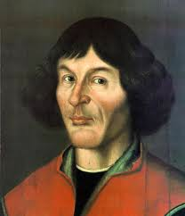

Notes:
Nicholas Capernicus - solar system

Slide 3
Notes:
Unique individuals. POINT: everyone is different

Slide 4
Learning Objectives
Discuss the potential impact of genetic profiles in relationship to drug response
Differentiate between the various metabolic pathways for drug metabolism
Discuss the advantages and disadvantages of pharmacogenomics on anesthesia practice
Discuss the financial implications of pharmacogenomics

Slide 5
What is Pharmacogenetics?
Pharmacogenetics
Specific genes or group of genes
Pharmacogenomics
Whole genome
MAIN POINT: Everyone has a different genetic makeup which affects an individual’s response to drugs.
Notes:
A few colleagues asked.. …IF YOU DON’T GET ANYTHING FROM LECTURE……Let’s Break down the word. Genetics is heredity information passed from parents to offspring. Pharmacy is drugs. So a persons genetics in relationship to their specific response to drugs.

Slide 6

Why is this important?
Adverse Drug Reactions
2.2 million serious events
106,000 deaths
4th leading cause of death
#1 cause of death for hospitalized patients
Cost
$136 billion per year
Notes:
Because pharmacogenetics impact Drug Reactions, specifically Adverse Drug Reactions
According to FDA
4th leading – ahead of diabetes, AIDs, MVAs, pneumonia, etc
Cost – more than CV and diabetic cost

Slide 7

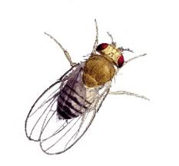
Where did pharmacogenomics come from?
History Lesson
1866 – Gregor Johann Mendel observed pea plants
1915 – Thomas Hunt Morgan studied the fruit fly
1940s – DNA on portion of chromosomes
1960s – Gene expression discovered
1970s – gene expression controlled and manipulated
End of 20th century – sequence of entire genome

Slide 8

Did You Know?
Anesthesia was at the forefront of this new discipline
Malignant Hyperthermia
Pseudocholinesterase Deficiency
Barbiturate-Induced Porphyria
1959 – Frederick Vogel termed the phrase “pharmacogenetics”
1962 – Werner Kalow published Pharmacogenetics: Heredity and the Response to Drugs
Notes:
The last slide was more genetics itself. Did you know that ANESTHESIA was at the forefront of pharmacogenetics.

Slide 9
Terminology
GENE – molecular unit of heredity
GENOTYPE - portion of your DNA that codes for a type of protein, enzyme, biological process, etc.
Holds the information to build and maintain cells
PHENOTYPE – a trait that results from a encoded gene
ALLELE – two per autosomal gene (one paternal and one maternal) form genotype
Heterozygotes – 2 different alleles
Homozyogotes – 2 same alleles
GENOME – “I become, I am born”
Entire organisms heredity information
23 chromosomes

Slide 10

Book Analogy
The book (genome) contains 23 chapters
Each chapter contains 48-250 million letters (A,T,G,C)
23 chapters x letters = 3.2 billion letters total in book
Book fits in library (cell)
One copy of the book (all 23 chapters) in every cell of body

Slide 11
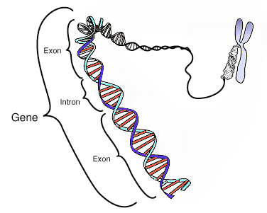

Slide 12
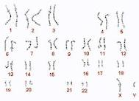
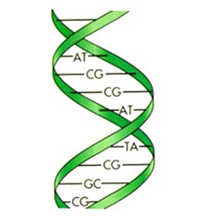

Slide 13


What Happens When Gene Expression Adapts?
Polymorphism – inside the cell from inheritance; variation among gene expression (not all bad)
e.g. CTTGAC vs CTCGAC
Enzymes, transport proteins, receptors
Mutation – outside the cell causing the change; is inheritable
Notes:
Not going over DNA transcription…..beyond the scope of lecture

Slide 14
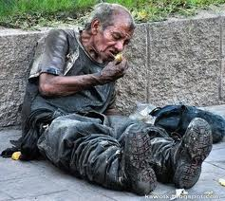
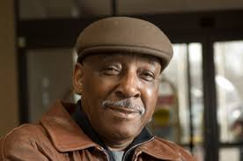

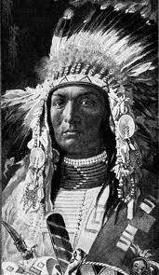
Factors influencing polymorphisms
Disease
Drugs
Surgery
Nutritional status
Biological variations
Race
Ethnic background

Slide 15
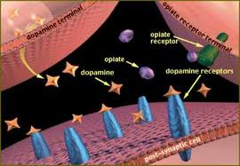
Implications of Polymorphisms
Enzyme needed for drug metabolism
Enzyme needed for biotransformation
Transport protein for drug transport (speed of absorption)
Receptor influencing drug affinity and response
Drugs with small therapeutic indexes
Notes:
So polymorphic changes can significantly effect us as anesthesia providers

Slide 16
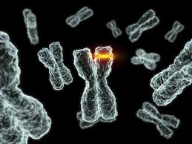
SPECIFIC POLYMORPHISMS
ENZYMES

Slide 17
Chromosome 3 mutation
Pseudocholinesterase Deficiency
First Documented genetic variation (polymorphism)
Can be inherited, acquired, or iatrogenic
Plasma cholinesterase produced in liver
Metabolizes succinylcholine, mivacurium, atricurium, ester type local anesthetics
1950s patient had prolonged muscle relaxation after succinylcholine administration
Review of normal pseudocholinesterase function
Classification System and Testing do exist
Notes:
ENZYMES. The most popular chromosome irregularity results in pseudocholinesterase def.

Slide 18
Plasma Assay for Pseudocholinesterase Deficiency
Classification | Homozygous Typical | Heterozygous Atypical | Homozygous Atypical
Description & Result | Two normal alleles Dibucaine # - 70 to 80 | One normal, one abnormal allele Dibucaine # - 50 to 60 | Two abnormal alleles Dibucaine # - < 30
Implication | Normal metabolism | Slightly to marked metabolism | Long and prolonged metabolism

Slide 19
New Pseudocholinesterase Classification
A variant – homozygous at increased risk for prolonged apnea
K variant – homozygous and 66% people have decrease in enzyme activity
AK variant – heterozygous, individuals have prolonged muscle relaxation (longer than 5 min but < 1 hr)
F variant – decreased activity
H variant – 10% reduction in enzyme activity
J variant - 33% reduction
S variant – most serious, 8 hrs apnea

Slide 20

Len Bias

Slide 21
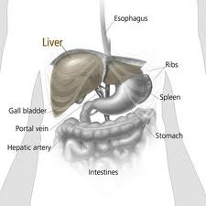
Cytochrome P450
Cytochrome P450 Enzymes
Phase I Reactions (oxidation, reduction, hydrolysis)
Phase II Reactions (conjugation)
57 different CYP450 genes identified
CYP1, CYP2, CYP3 families most crucial for drug metabolism
Notes:
MORE ENZYMES

Slide 22
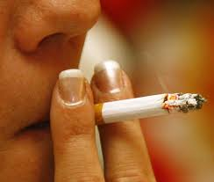

Cytochrome P450
Speed Up – phenobarbital, St. Johns Wart, rifamycins, polycyclic hydrocarbons (i.e. smoking)
Slow Down – calcium channel blockers, grapefruit juice, erythromycin, cimetidine, ketoconazole, oral contraceptives

Slide 23
INHIBITORS
INDUCERS
Fluroquinolones
Fluvoxamine (SSRIs)
Calcium Channel Blockers
Herbal Teas
Cimetadine
Amiodarone
Interferon
Mathoxelene
Grapefruite Juice
Cumin
Quinidine
Buproprion
Haldol
H1 Antagonists
Celecoxib
Cocaine
Ticlopidine
Terbinafine
Methadone
Doxyrubicin
Metoclopromide
Tobacco
Broccoli
Brussels Sprouts
Echinacea
Chargrilled Meats
Cauliflower
Insulin
Nafcillin
Omeprazol
Methylcholenthrene
Modafinil
Dexamethasone
Rafampicin
Glutethamide
Phenytoin
Oxycarbazepine
Efavirenz
Modafinil

Slide 24
Specific CYP450
CYP2E1
Breaks down inhalational agents
Polymorphisms due to BMI, diet, alcohol consumption, age
CYP3A4
50% of medications requiring phase I metabolism
Opioids, benzodiazepines, local anesthetics, immunosuppressants, antihistamines
Wide genetic variability (usually little clinical significance)
Will respond to inducers and inhibitors (previous slide)

Slide 25
CYP2D6
25% drugs that undergo phase I reactions
Extensive genetic variability!
1,000 fold difference in metabolism of drugs between phenotypes
This polymorphism can greatly contribute to ADRs
Antiemetics, beta-blockers, codeine, tramadol, oxycodone, hydrocodone, tamoxifen, antidepressants, neuroleptics, antiarrythmics

Slide 26
CYP2CP & CYP2C19
CYP2CP
Metabolizes phenytoin, NSAIDS, celecoxib, warfarin
Studies indicate that testing can provide safe and effective dosing
More personalized medicine
Therapeutic levels sooner w/o life threatening side effects
CYP2C19
Phenytoin, amitriptyline, barbiturates, diazepam, PPIs (omeprazole, pantoprazole, etc)

Slide 27
CYTOCHROME P450 ENZYME CLASSIFICATION SYSTEM
Classification | Poor Metabolism | Intermediate Metabolism | Extensive Metabolism* | Ultrarapid Metabolism
Description | Lack both copies of the functional allele | Heterozygous for 1 functional and 1 deficient allele or 2 partially defective alleles | Two functional alleles *majority of population | Three or more functional alleles
Implication | Extremely slow metabolism | Slightly to marked slow metabolism | Normal metabolism | Very Fast Metabolism

Slide 28
Audience Response
Have you experienced cytochrome p450 pharmacogenetic test results on your patients?

Slide 29
SPECIFIC POLYMORPHISMS
RECEPTORS

Slide 30
RYR1 Gene Mutation on Chromosome 19
Malignant Hyperthermia
Hypermetabolic syndrome, life threatening (inherited genetic polymorphism)
Triggers: IA and Sux
Cause: rapid release of Ca++ from sacroplasmic reticulum
Increased metabolic state, 02 consumption, increased CO2, increased Body temp
1:5,000 – 1:50,000 adults, 1:15,000 kids
50 mutations in association w/ MH
Ryanodine receptors mediate calcium release from sarcoplasmic reticulum
Notes:
RECEPTOR!

Slide 31
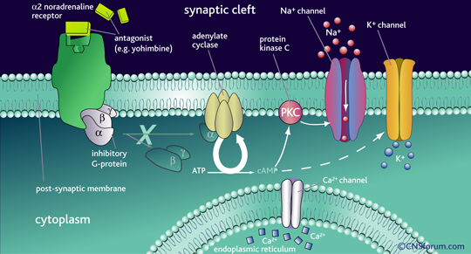
RYR1
MH = ⬆Ca⁺⁺

Slide 32
Caffeine Halothane Contracture Test
Muscle biopsy – exposed to Halothane and caffeine
Very sensitive
Downsides: expensive, invasive, limited sites
CH test: Canada, Maryland, California, Minnesota, NC
Molecular Test: Pennsylvania, Wisconsin
Genetic testing for pts that have tested positive and families
Screens for 17 most common RYR1 mutations
Only 25% of people are identified bc so many mutations
80% morality 30yrs ago, 5% today
Notes:
Mhaus.org

Slide 33

μ opioid receptor
Most common μ receptor – OPRM1
Most common polymorphism
Substitution of A (adenine) for G (guanine) in position 118
G118 allele trait – results in decreased response to opioid potency
Decreased incidence of opioid ADRs (n/v, sedation, drowsiness)
Increased opioid requirement intra-op
Increased response to naloxone

Slide 34

5HT Receptor
7 different family of Serotonin Receptors (5HT1 – 5HT7)
Subunits (i.e. 5HT3 – five subunits alone!)
Most Research from Psychologists
Greatly influences a persons response to antipsychotics, schizophrenic, etc meds
SNP on chrom 13
5HT2a
Pt doesn’t respond to Clozapine

Slide 35
SPECIFIC POLYMORPHISMS
PROTEIN TRANSPORTERS

Slide 36
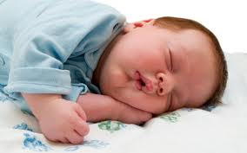

Protein Transporters
P glycoprotein
Multdrug resistance protein 1
Coded by ABCB1 gene
Active efflux transporter on BBB
Altered P glycoprotein could have enhanced entry of some drugs (morphine, methadone, fentanyl and fentanyl analogues)

Slide 37
Quick Quiz
Pt 22 yr old female on oral contraceptive, drank a glass of grape fruit juice for lunch, and is a known “poor metabolizer” CYP2C19. How will she respond to her regularly scheduled dose of amitriptyline (elavil)?
56 yr old male. Smoker. Known as an “ultra-rapid metabolizer” of CYP2D6 taking tramadol for post op pain following a TKA. How will patient respond?
82 yr old male. BMI 40. Status post MIx2. CABG and COPD. Smoker ppd x30 yrs. Takes Echinacea, St. John’s Wart, Warfarin, Norvasc and Crestor at home. He is known for being an intermediate metabolizer of CYP3A4. How will he respond to prilosec?
37 yr old. ASA 1. Pt has a OPRM1 Mutation. Given fentanyl intra-op for a lap chole. How will he respond?

Slide 38

Interesting Studies
“Bring Your Genes to Cal”
5500 undergrads received DNA collection kits
700 returned saliva sample
Testing for gene that encodes for ALDH2 (aldehyde dehydrogenase)
Enzyme responsible for metabolism of acetaldehyde (byproduct of alcohol)
Elevated blood and saliva acetaldehyde levels
Increased Cancer
Decreased abuse
Litigation
Bill (AB70) and California Dept of Health Stopped Study
No way you’re telling students of potential cancer causing genetic defect
Berkley Daily Planet

Slide 39
Alcohol
ADH + Liver Enzymes
Acetaldehyde
ALDH2
Acetic Acid

Slide 40
Alcohol
ADH + Liver Enzymes
Acetaldehyde
ALDH2*2 Allele
Acetic Acid

Slide 41


Caffeine
Individual variation
External Factors
E.g. smoking 30-50% increase in metabolism
Oral contraceptives can double half life
More you drink – enzyme induction
Internal factors
Genetic polymorphisms (CYP1A2)
N-acetyltransferase
“Fast Acetylators and Slow Acetylators”
Urine test now available to recognize for NAT2 variant
Jetter et al, Eur J clin Pharmacol

Slide 42
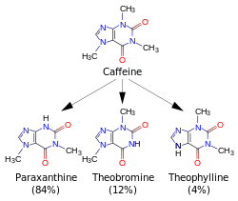
CYP1A2 +N-Acetyltransferase
Notes:
Paraxanthine – increases lypolysis (fatty acids in body)
Theobromine – Dialates blood vessels
Theophyline – relazes smooth muscle (brochodialation)

Slide 43
OPRM1 & COMT
Does OPRM1 and COMT impact opioid use and post-op pain?
79 Orthopedic Trauma pts
Performed saliva sample DNA (COMT & OPRM1)
OPRM1 findings consistent with others
*Novel finding – COMT SNP (GCGG) predicts higher pain scores, higher opioid requirements, higher HR
Henker et al., Biol Res Nur 2012
Notes:
RICK HANKER…..UPMC

Slide 44
Explanation
CATACHOLAMINES
OPIOID
COMT
OPRM1
BY PRODUCTS
Longer Hospital Stays ?

Slide 45
CYP2D6 on PONV
112 orthopedic trauma patients, 18-70 yrs old
6% poor metabolizers
30% intermediate metabolizers
63% extensive met
0% ultra rapid
Pt’s classified as poor metabolizers = decreased PONV and increased pain scores.
Wesmiller et al., Bio Res Nur 2012

Slide 46
ANTIEMETICS
CYP2D6
CTZ
Longer Hospital Stays?

Slide 47
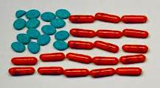
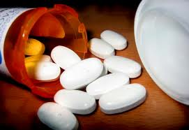


Specific Drugs

Slide 48
Warfarin
Metabolized principally by CYP2C9
Target receptor is on enzyme VKOR
Narrow therapeutic index and wide interpatient variability
Associated with some of the highest rates of adverse events and ER visits of among any single drug
2 million patients are started on coumadin each yr in US
20% are hospitalized within the first 6 months (bleeding)
Can we improve warfarin therapy?

Slide 49
GENETIC POLYMORPHISMS of WARFARIN
Defect | CYP2C9 and CYP2C9*1 | CYP2C9*2 and CYP2C9*3 | CYP2C9*3 | CYP2C9*1 and CYP2C9*3 | CYP2C9*1 and CYP2C9*2 | CYP2C9*2
Description | Metabolize very well, “extensive” | Mutations in exons 3 and 7 of CYP2C9. | Homozyg., mutation | Heterozyg. mutation | Heterozyg murtation | Homozyg. Mutation
Result | Nomral | Slightly less metabolism of warfarin; Increased response | 90% reduction of metabolism, Very increase response | 50-70% reduction in metabolism | 50-70% reduction in metabolism | 50-70% reduction in metabolism
Demographics |  |  | %6 whites 1% African Americans 3% Asians |  |  | %8 whites %1 African Americans Rare in Asians
Notes:
ENZYME POLYMORPHISM

Slide 50
Warfarin Target Polymorphism
Warfarin’s Target VKOR (Vitamin K 2,3 –epoxide reductase)
Warfarin inhibits VKOR to reduce Vit K dependent clotting factors (thin blood) produced in liver
Patients with VKORC1* variant will require less warfarin
Higher affinity for Warfarin (lessen requirements)
25% of the polymorphisms in the VKORC1
Notes:
RECEPTOR POLYORPHISM

Slide 51
VKOR
(Vitamin K 2,3 – epoxide reductase)
VIT K
Consumption
Activation of VIT K
Liver Factors 2, 7, 9, 10

Slide 52
Warfarin
VKOR
(Vitamin K 2,3 – epoxide reductase)
VIT K
Consumption
Activation of VIT K
Liver Factors 2, 7, 9, 10

Slide 53
Warfarin (⬆ affinity)
VKORC1*
* (Vitamin K 2,3 – epoxide reductase)
VIT K
Consumption
Activation of VIT K
Liver Factors 2, 7, 9, 10
Decreased Dose Requirements = Less II, VII, IX, X

Slide 54
Testing and Warfarin
FDA has approved 4 Warfarin pharmacogenetic test kits
More payers willing to fund genetic testing
Current FDA label
Dose requirements are influenced CYP2C9 and VKORC1
Genetic Tests can assist in selecting starting dose
Product label includes a table of expected therapeutic warfarin doses based CYP2C9 and VKORC1 genotypes
Several Studies underway to further reinforce genetic testing

Slide 55
Clopidogrel
Taken by 40 million patients worldwide
Used to prevent thrombotic events
Prodrug
Converted by CYP2C19
recurrent cardiovascular events due to polymorphisms in CYP2C19 (loss of function alleles)
Demographics: 24% whites, 18% Hispanics, 33% African Americans, and 50% Asians
3-4% of population

Slide 56
Significant Plavix Studies
A. 227 Cardiac patients
21% w/ variant CYP2C19 had cardiovascular ischemic event or died during 1 year follow up compared with 10% of those with normal CYP2C19
B. 12 yr prospective study; 300 Cardiac patients
Used CV death, nonfatal MI, and urgent coronary revascularization as end points. Concluded that CYP2C19 was only independent predictor
More Testing Being Done
Current FDA boxed warning states that poor CYP2C19 metabolizers may not benefit from the drug

Slide 57
Current Programs
Joint endeavor by specialty pharmaceutical manufacturer Pacira Pharmaceuticals and therapeutic management firm GeneAlign
Identify preoperative patients who may be predisposed to developing dependence on opioid analgesics
Specific guidance on opioid selection will be given with regard to metabolic phenotype CYP (hepatic cytochrome P450) 2D6 and others, as well as regarding response gene phenotypes OPRM1 (mu-opioid receptor)
Anesthesiology News May 2017
http://www.anesthesiologynews.com/Pain-Medicine/Article/05-17/Companies-Collaborate-To-Reduce-Postsurgical-Opioid-Dependence/41245/ses=ogst?enl=true

Slide 58
Current Programs
VA Partners with Private Company on Genetic Tests
$25 million dollar donation from philanthropist
Provide testing to > 250,000 veterans
More therapeutic drug dosages – specifically targeting antidepressants, anticoagulants and opioids
USA TODAY March 13, 2019

Slide 59

Show me the money!
Not well documented/published
Pre-op testing in US is $3-18 bil annually
MH hal/caf test $6,000
MH genetic testing $800
Testing does cost money, but…
55.14% problems prevented
59.3% reduced cost
Notes:
I read a chapter in Barash or one of the bibles in anesthesia and it said that pre-op testing does cost money BUT….. If you would have had the complication that you prevented you would add 60% additional cost!

Slide 60

The Future of Pharmacogenetics
Positive
Negative
Excellent potential for a tailor-made anesthetic
Individualized medicine
Patient Satisfaction
Decreased ADRs
Improve Drug efficacy
Financial ?
Legal & ethical considerations
Financial concerns
More research

Slide 61
Questions?

Slide 62
References
Ama T, Bounmythavong S, Blaze J, Weismann M, Marienau M, Nicholson W. Implications of Pharmacogenomics for Anesthesia Providers. AANA Jounrnal. 2010; 78 (5): 393-399
Lotsch J, Skarke C, Jurgen L., Geisslinger G. Genetic predictors of the clinical response to opioid analgesics: clinical utility and future perspectives. Clinical Pharmacokinetics. 2004; 43 (14): 983-1013
Iohom G, Fitzgerald D, Cunningham AJ. Principals of pharmacogenetics: implications for the anaesthetist. Br J Anaesth. 2004; 93 (3): 440-450.
Streetman DS. Emergence and evolution of pharmacogenetics and pharmacogenomics in clinical pharmacy over the last 40 years. Ann Pharmacother. 2007; 41 (12): 2038-2041
Kalow W. Human pharmacogenomics: the development of a science. Hum Genomics. 2004; 1 (5): 375-380.
Motulsky AG. Drug reactions, enzymes, and biochemical genetics. JAMA. 1957; 165 (3): 835-837
Weinshilboum R. Inheritance and drug response. N Engl J Med. 2003. 348(6):529-537.
Wilkson GR. Drug metabolism and variability among patients in drug response. N Engl J Med. 2005; 352(21): 2211-2221.
Galley HF, Hahdy A, Lowes Da. Pharmacogenetics and anesthesiologists. Pharmacogenomics. 2005; 6 (8): 849 – 856
International Human Genome Sequencing Consortium: Lander ES, Linton LM, Birren B, et al. Initial Sequencing and analysis of the Human genome. Nature. 2001; 409 (6822): 860-921

Slide 63
References
Fillingim, R.B., Kaplan, L., Saud, R., Ness, T.J., Glover, T.L., Campbell, C.M., & Wallace, M.R. (2005). The A118G Single nucleotide polymorphism of the mu-opioid receptor gene (OPRM1) is associated with pressure pain sensitivity in humans. Journal of Pain, 6, 159-167.
Furst, S. (1990). Brain monamines are involved in the sedative effects of opiates and neuroleptics. Progress in Clinical Biological Research, 328. 311-314.
Pattinson, K.T.S. (2008). Opioids and the control of respiration. British Journal of Anaesthesia, 100. 747-758.
Purcell, S., Neale, B., Todd-Brown, K. Thomas, L., Ferreira, M. A., Bender, D., & Sham, P.C. (2007). PLINK: A tool set for whole genome association and population-based linkage analyses. American Journal of Human Genetics, 81, 559-575.
Zaykin, D.V., Westfall, P.h., Young, S.S., Karnoub, M.A., Wagner, M.J., & Ehm, M.G. (2002). Testing association of statistically inferred haplotypes with discrete and continuous traits in samples of unrelated individuals. Human Heradity, 53, 79-91.
Daly, A., Brockmoller, J., Broly, F., Eichelbaum, M., Evans, W., Gonzalez, F., & Zanger, U.M. (1996). Nomencalture for human CYP2D6 alleles. Pharmacogenetcs., 6, 193-201.

