Slide 1
Patient Selection in the Ambulatory Surgery Setting:
With a Focus on Obstructive Sleep Outpatient Setting
Tracy Paul Young, MSNA, MBA, CRNA

Slide 2
Objectives
Discuss healthcare trends leading to the rapid expansion of Ambulatory Surgery in the US
Identify evidence-based ASC patient selection guidelines.
Identify unique risk factors associated with ASC care.
Discuss tools used to screen patients for OSA.
Identify evidence-based treatment options for patients with OSA in ASC.

Slide 3
What is an Ambulatory Surgery Center?
CMS defines an Ambulatory Surgery Center (ASC) as “any distinct entity that operates exclusively for the purpose of providing surgical services to patients not requiring hospitalization and in which expected duration of services would not exceed 24 hours following an admission.”
  42 CFR 416.2 Definitions

Slide 4
Ambulatory Surgery in the US
There are over 6,000 ASCs in America
  97% are for-profit
  3% not for-profit
  First ASC in US opened in 1970 in Phoenix Az.
ASCs are either single-specialty or multi-specialty
More than 60% of the surgical and nonsurgical procedures performed in the U.S. (53.3 million) were done on an outpatient basis in 2007, Up to 66% in 2014 and still climbing.
Average ASC in US is 3.9 ORs, 2.01 Procedure rooms and 14,800 square feet.

Slide 5
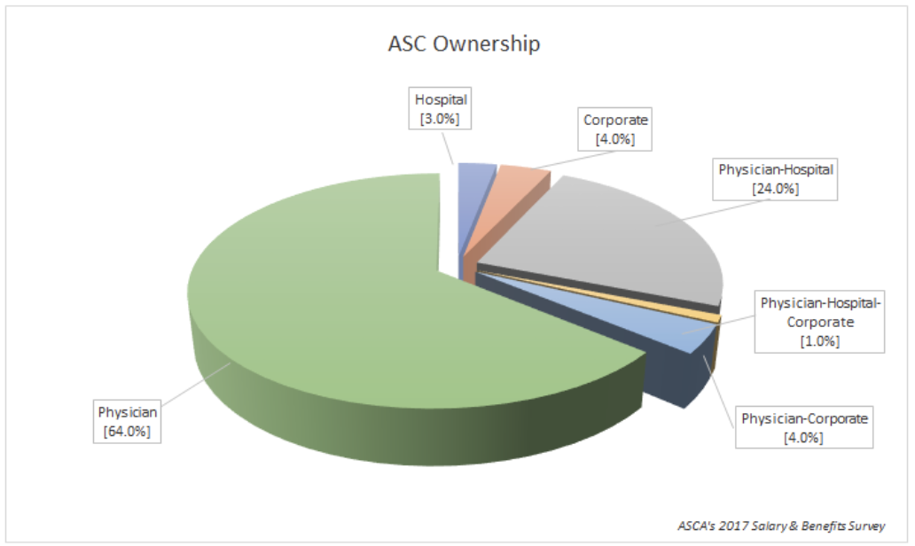

Slide 6
Ambulatory Surgery in the US
Most common procedures performed in ASCs
Cataract Surgery (17%)
Colonoscopy (14%)
Interventional Pain Injection, lumbar, cervical etc. epidural, paravertebral, foramen (12%)
Upper GI Endoscopy (8%)

Slide 7
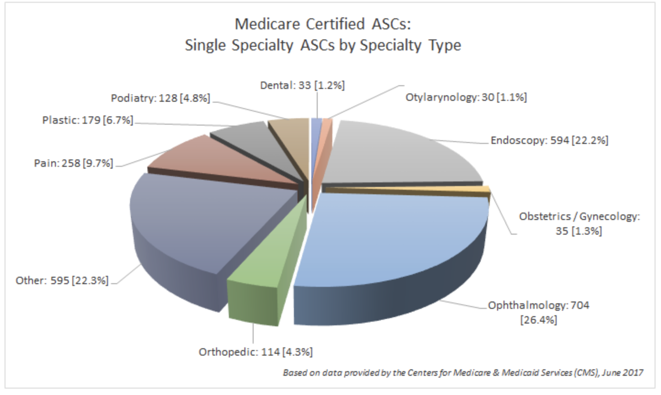

Slide 8
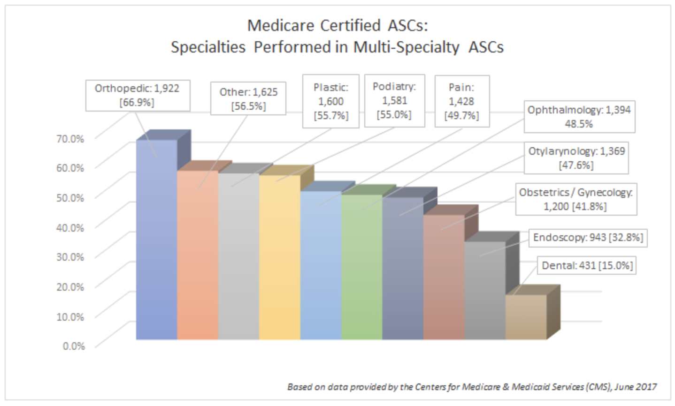

Slide 9

Benefit of ASCs to Healthcare System
Typical ASC cost is 30-40% less expensive than hospital cost
Strong evidence of quality delivery of care
Value-based delivery of care in agreement with principles of ACA
Patient not exposed not hospital environment

Slide 10
Benefits of ASCs
ASCs = Efficient Quality Care + Convenience + Patient Satisfaction
The ASC health care delivery model enhances patient care by allowing physicians to:
Focus exclusively on a small number of processes in a single setting, rather than having to rely on a hospital setting that has large-scale demands for space, resources and the attention of management
Intensify quality control processes since ASCs are focused on a smaller space and a small number of operating rooms
Allow patients the ability to bring concerns directly to the physician operator, who has direct knowledge about each patient’s case, rather than deal with hospital administrators, who almost never have detailed knowledge about individual patients or their experiences
  ASC Asscoiation http://www.ascassociation.org/advancingsurgicalcare/aboutascs/industryoverview/apositivetrendinhealthcare

Slide 11

Who Regulates ASCs?
CMS- Centers for Medicare and Medicaid Services
TJC- The Joint Commission on Accreditation of Healthcare Organization
State Departments of Health and Human Services
AAAHC- Accreditation Association for Ambulatory Health Care
AAAASF- American Association for the Accreditation of Ambulatory Surgery Facilities
Insurance Companies through Audit, Inspections and Risk Management and Analysis

Slide 12

Risk Factors Associated with Ambulatory Surgery
Typically less resources available for emergencies when complications occur
Often hospitals are better equipped with more advanced modalities, medical specialist and medications
Often hospital is better staffed, and staff training may be better to handle emergencies
And ASCs are not prepared to manage higher acuity patients during the peri-operative period (specifically post operatively)

Slide 13

Mitigation of Perceived Risk Factors
Staff training and drills in order to be prepared for emergencies and complications
Adequate equipment to handle emergencies and complications
Proper patient selection and preoperative evaluation is paramount!

Slide 14
Patient Selection Risk Factors
Despite numerous studies and systematic reviews, there is lack of scientific evidence to make strong recommendations, however
The following factors have been found in the literature that present an increased risk for hospital admission or death following outpatient surgery:
Patient age greater than 85 years
Cardiovascular and/or Peripheral vascular disease
Operating room (OR) time greater than one hour
Malignancy
Obesity
Obstructive Sleep Apnea
Hyperactive reactive airway disease
End Stage Renal Disease (ESRD)
A requirement for general anesthesia

Slide 15
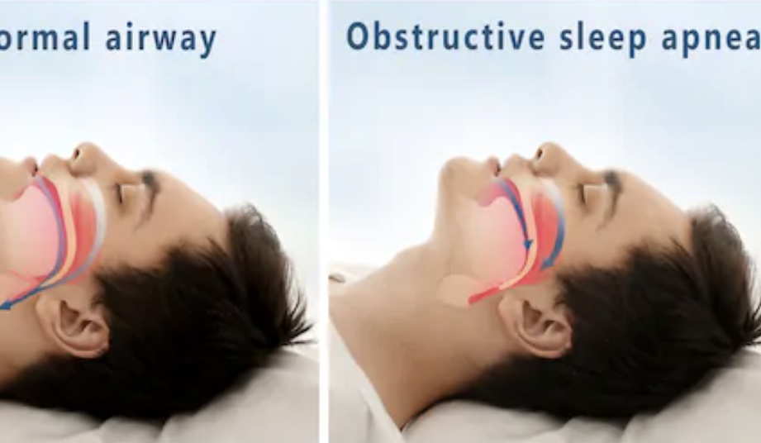
Patient Selection Risk Factors
Obstructive Sleep Apnea: A closer look
Obstructive sleep apnea (OSA) is a common sleep-related breathing disorder characterized by repetitive, periodic, partial or complete obstruction of the upper airway during sleep, with periods of breathing cessation lasting for more than 10 seconds.

Slide 16
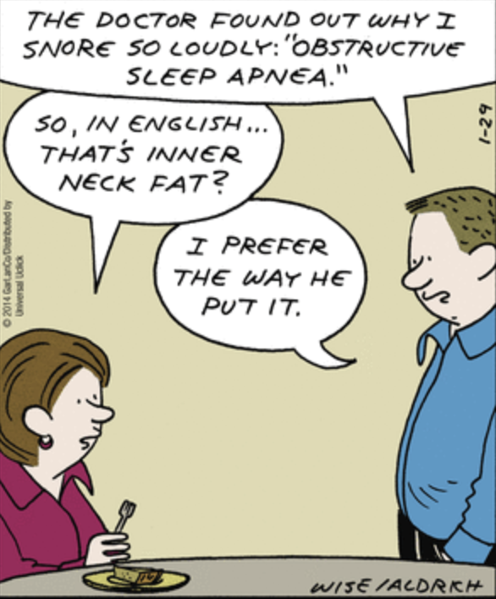

Slide 17
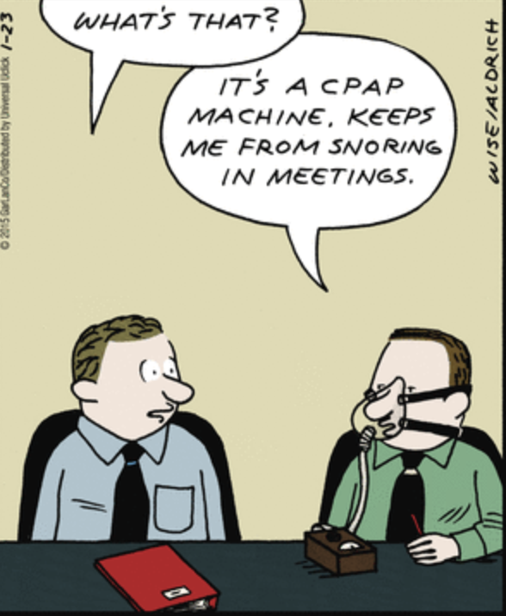

Slide 18


Slide 19
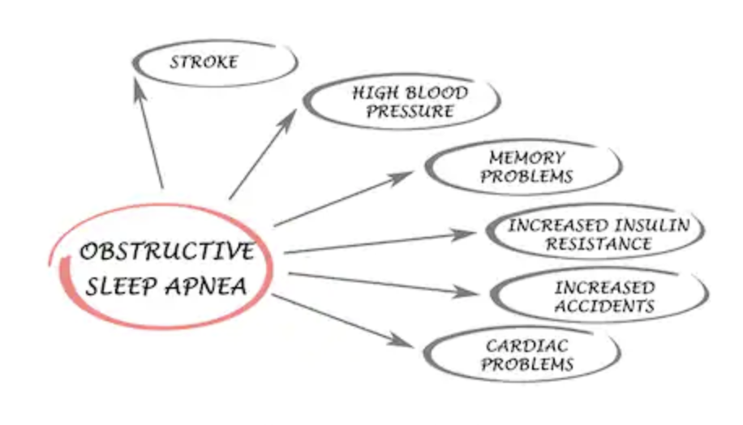
Obstructive Sleep Apnea: A closer look
OSA affects approximately one of four adults in the United States.
Approximately 90 percent of people go undiagnosed
OSA is chronic disorder that requires lifelong care
OSA occurs in children as well, frequently secondary to adenotonsillar hypertrophy or childhood obesity

Slide 20
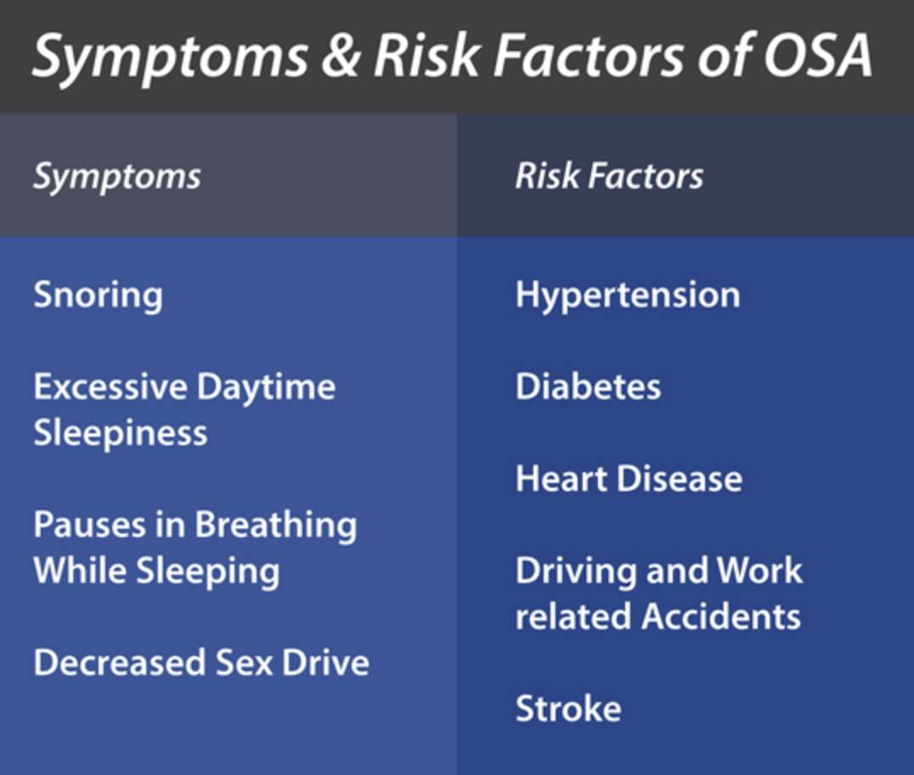
Obstructive Sleep Apnea: A closer look
Signs and Symptoms of OSA:
Snoring, restlessness or resuscitative snorts during sleep
Respiratory efforts during arousals from sleep
Daytime symptoms due to disrupted sleep, such as sleepiness, fatigue or poor concentration

Slide 21
Obstructive Sleep Apnea: A closer look
OSA is independently associated with postoperative pulmonary and cardiac complications in the inpatient setting
Despite an increase rate of complications, the literature did not find an increase in in-hospital mortality
Memtsoudis et al., 2014: Over 500,000 patient undergoing total hip and knee arthroplasty found an increase in pulmonary and cardiac complications in OSA patients
Mokhlesi et al., 2013: Over 1M hospitalized patients undergoing elective surgery found an increased risk of postoperative cardiopulmonary complications in OSA patients.

Slide 22
Obstructive Sleep Apnea: A closer look
Staff in The Joint Commission’s Division of Healthcare Improvement cites the following concerns regarding OSA:
Lack of training for health care professionals to screen for and recognize OSA
Failure to assess patients for OSA
Lack of guidelines for the care and treatment of individuals at risk for, and those diagnosed with, OSA
Failure to implement appropriate monitoring of patients with risk factors associated with OSA
Lack of communication among health care providers regarding patients with OSA or potential risk factors associated with OSA
Lack of pre/postoperative evaluation and treatment for OSA

Slide 23
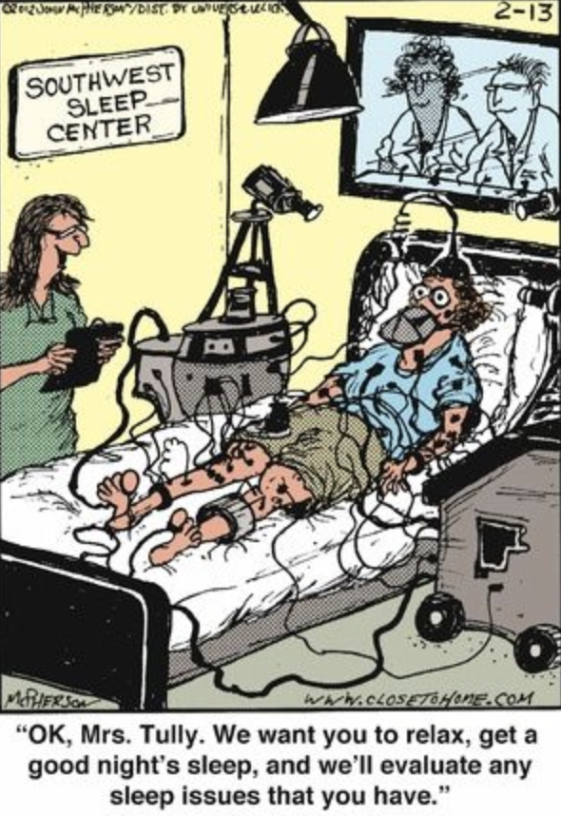
Obstructive Sleep Apnea:
Common Screening Tools for OSA:
The Epworth Sleepiness Scale (ESS)
Apnea Risk Evaluation System (ARES)
The Berlin Questionnaire
The STOP-Bang Questionnaire

Slide 24
Obstructive Sleep Apnea: A closer look
The STOP-Bang Questionnaire
S = Snoring. Do you snore loudly (louder than talking or loud enough to be heard through closed doors)?
T = Tiredness. Do you often feel tired, fatigued, or sleepy during daytime?
O = Observed Apnea. Has anyone observed you stop breathing during your sleep?
P = Pressure. Do you have or are you being treated for high blood pressure?
B = BMI > 35 kg/m2
A = Age > 50 years
N = Neck circumference > 40 cm
G = Male Gender

Slide 25
STOP-Bang Questionnaire
Studies have found that a score of ≥ 3 could be used to screen for OSA in surgical patients with high prevalence of OSA such as bariatric surgery
A score of 5-8 could be used to screen the general population.
STOP-Bang has high sensitivity of 93% when a score of ≥ 3 is used to detect moderate and severe OSA.

Slide 26
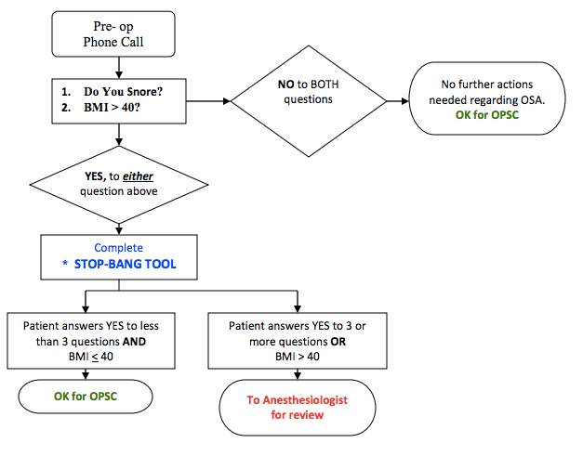
Anesthesia Assessment and Decision Making

Slide 27
Anesthesia Assessment and Decision Making
Society for Ambulatory Anesthesia (SAMBA) Consensus Statement on Preoperative Selection of Adults with Obstructive Sleep Apnea
Recommends Preoperative Screening for OSA with STOP-Bang questionnaire
Patient receiving presumptive diagnosis of OSA from STOP-Bang with optimized co-morbidities and a predominant non-opioid analgesic technique can proceed with ambulatory surgery
  Algorithm next slide:

Slide 28
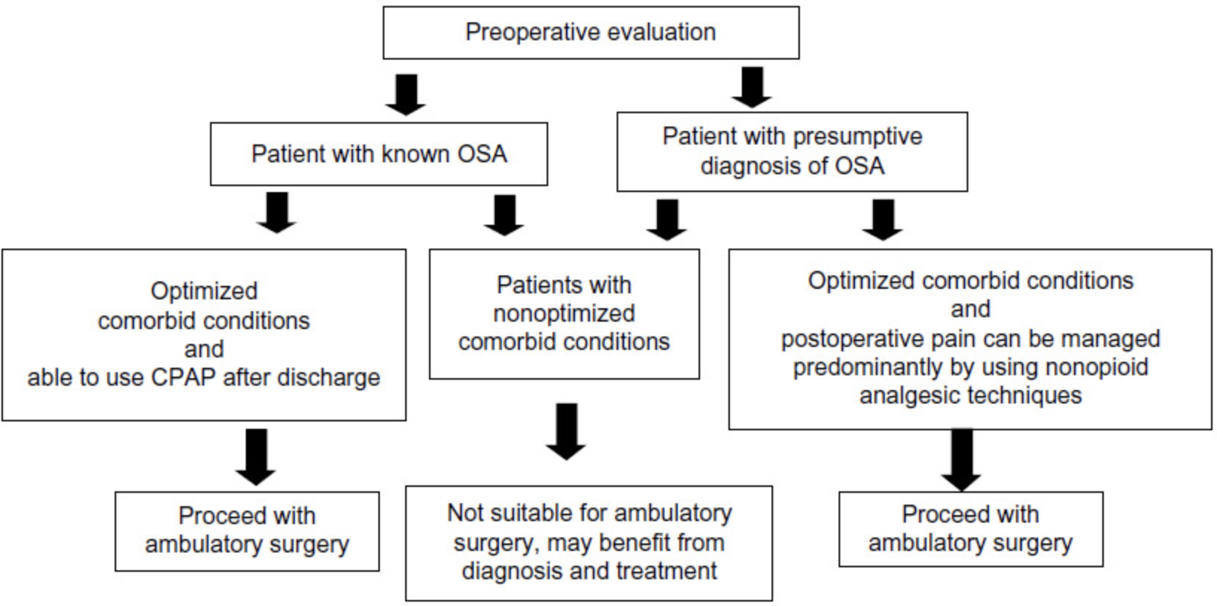

Slide 29
Anesthetic Considerations for Out-Pt OSA Patients
Use regional/local anesthetic techniques, whenever possible.
For GA, use a technique that allows early emergence.
Minimize opioid use (use non-opioid analgesics: regional analgesia techniques, wound infiltration with local anesthetics, acetaminophen, NSAIDs, and dexamethasone [if no contraindications]).
Use shorter-acting opioids (remifentanil, with longer-acting opioids (e.g., morphine and hydromorphone) titrated to effect postoperatively in more controlled manner.
Use prophylactic antiemetics: ondansetron (4 mg) and dexamethasone (4 mg, if no contraindication).
Tracheal extubation performed “awake.”

Slide 30
Post-Operative Considerations for OSA
Maintain patient in a 25-30º head-up position, if no contraindications.
Monitor for apneic episodes. Exercise caution in OSA patients who develop prolonged and frequent severe respiratory events (e.g., sedation analgesic mismatch, desaturation, and apneic episodes). If SaO2 ≤85% on 2-3 L/min, use CPAP or BiPAP early.
Pain control:
  Use non-opioids (acetaminophen 1 gm, po and ibuprofen 800 mg, po, if no contraindication).
  Field/peripheral nerve blocks can be placed postoperatively.
  Titrate morphine or hydromorphone to effect (i.e., attempt to make patient comfortable, not to achieve a particular pain score). Balance degree of pain with concerns of sedation and respiratory depression.
Monitor in PACU until completely awake (Ramsay sedation score 1 or 2), maintains SaO2 at baseline, and pain is controlled (most adverse events occur within 2 hours after surgery).

Slide 31
Post Discharge Considerations for OSA
Patients who are placed on OSA protocol based on clinical indicators should receive a letter for follow-up with their primary physician for possible sleep study.
Patients on preoperative CPAP should be instructed that it is imperative that they use CPAP when sleeping, daytime or nighttime.
Patients should be instructed to avoid opioids, if possible, and not to take sedatives and/or muscle relaxants.

Slide 32
Patient Selection Risk Factors Review
The most important factor in deciding if a surgical case is appropriate is not how many medical problems the patient has, but rather the magnitude of the surgical procedure and required anesthetic in conjunction with medical condition.
There is no magic formula for proper patient selection based on literature review
Considerable differences of opinions exist between providers and professional organization

Slide 33
Know your Facility
Once you look patient specific issues and surgical considerations you then must look at specific facility factors to finally make your decision.
Not all ASCs are created equal
Know what equipment you have on site (Advanced airway techniques, US for blocks, etc)
Know your staffing resources and their level of comfort
Know what drugs and other ancillary services are available to you should you need them

Slide 34
Case Discussions
Appropriate or Not-appropriate for an ASC?
Case #1:
A 45-year-old obese male, BMI of 37, controlled HTN for a knee arthroscopy with medial meniscectomy. No previous Diagnosis of OSA but scored 4 on the STOP-Bang Questionnaire.

Slide 35
Case Discussion #2
Appropriate or Not appropriate for an ASC?
Case #2
Same 45-year-old obese male, BMI of 37, controlled HTN for Uvulopalatalpharyngoplasty (UPPP). Same score of 4 on the STOP-Bang Questionnaire.

Slide 36
Case Discussion #3
Appropriate or Not-appropriate for an ASC?
Case #3:
A 62-year-old female, BMI of 25, history of hypothyroid and a know difficult airway from previous surgery secondary to ankylosing spondylitis for a bunionectomy.

Slide 37
Case Discussion #4
Appropriate or Not-appropriate for an ASC?
Case #4:
A 76-year-old male, COPD, HTN, CAD, S/P CABG 8 years prior, NIDDM, and GERD for a Left Cataract Extraction with IOL.

Slide 38
Q and A
Thank you!
Tracy Paul Young CRNA, MSNA, MBA

