Slide 1
Surgical Pain Management for Hot patients
Thomas Baribeault DNP CRNA
@BaribeaultOFA

Slide 2
1.
Terminology

Slide 3
HOT
Long term opioid therapy
Untreated Opioid Use Disorder
Medication assisted therapy
Fibromyalgia

Slide 7
2.
Pre-operative Assessment

Slide 8
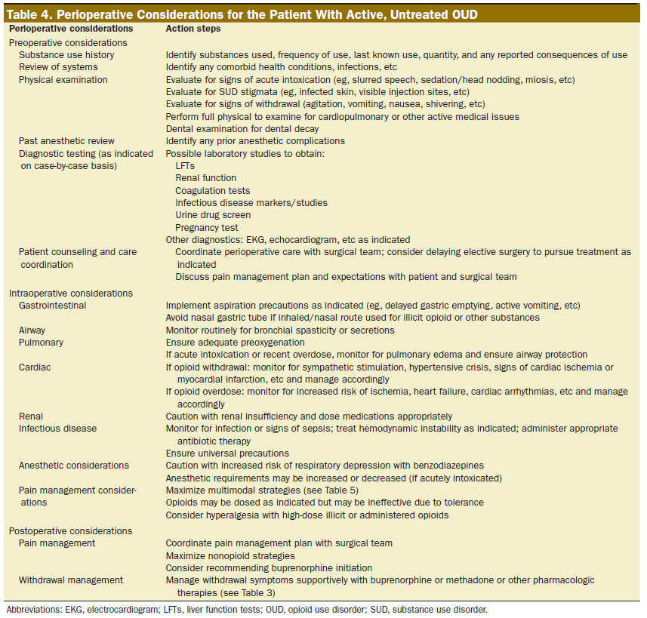

Slide 9
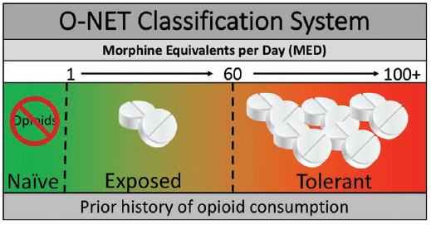

Slide 11
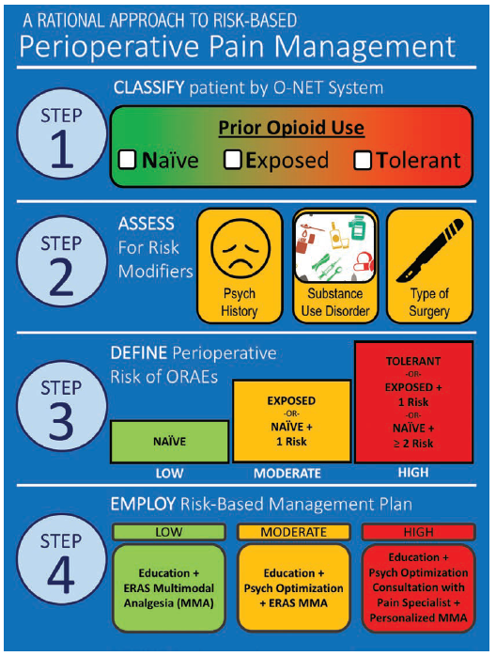

Slide 12
3.
MOUD

Slide 14
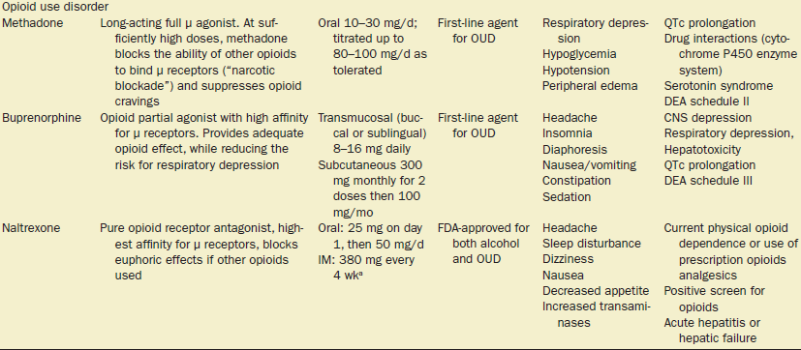

Slide 16
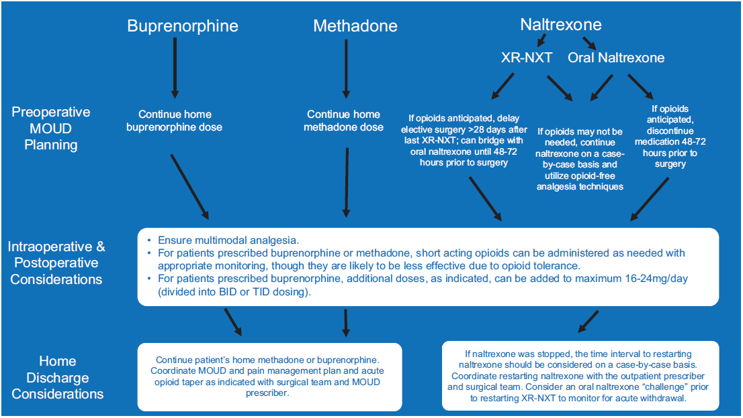

Slide 17
Considerations
Methadone
OUD dosing is higher than pain dosing, do not increase outpatient dose
May have Opioid Induced Hyperalgesia and Tolerance
Especially sensitive to benzodiazepines
Switch from PO to IV dosing
½ daily dose, divided Q6H
Standard opioids PRN
Use Narcan infusion for respiratory depression

Slide 18
Considerations
Buprenorphine
Doses less than 16mg/day has fewer receptors occupied
Can increase dose up to 24 mg/day for analgesia
Split dose into BID or TID
Sufentanil only opioid with higher affinity for opioid receptor
Hydromorphone close second

Slide 19
Considerations
Naltrexone
Opioid Free Anesthesia
Aggressive regional anesthesia

Slide 20
4.
Fibromyalgia

Slide 21
Fibromyalgia
Multiple conditions
Similar pathophysiology
Diagnosis
Widespread pain index >7
Symptom severity score >5
>3 months
Not explained by any other condition
Fibromyalgia-ness score
Predictive of post-operative pain and opioids requirements

Slide 22
Fibromyalgia
Symptoms
Magnified sensory transmission
“volume knob concept”
Pain, allodynia (tender points), heat & cold, auditory, and visual stimuli
+/- inflammation
Sleep disruption
Memory problems
Poor exercise tolerance
Depression

Slide 23
Fibromyalgia
Treatment
Aerobic exercise
Cognitive behavioral therapy
Medical
Anti-depressants
TCA Amitriptyline
SSRI/SSNI Duloxetine
Gabapentinoid
Gabapentin/Pregabalin

Slide 24
Fibromyalgia
Treatment
Tizandine
Tramadol/Tapentadol
Unsuccessful
Opioids
Overproduction of endogenous opioids

Slide 25
5.
Pharmacology

Slide 27
Ketamine
Dose
0.1-0.3 mg/kg
0.3-0.5 mg/kg
0.1-0.5 mg/kg/hr = 2-10 mcg/kg/min
1:1 morphine PCA
Mechanism
Blocks NMDA receptor

Slide 28
Ketamine
Benefits
Bronchodilator
Treatment for depression, suicidal ideation, and PTSD
Considerations
Caution cardiovascular disease, increased ICP, and catecholamine depression
Hallucinations/disassociation
Reverse and prevent OIH/OT

Slide 29
Lidocaine Infusion
Dose
1-2 mg/kg
2-3 mg/kg/hr
1-2 mg/kg/hr
Mechanism
Systemic analgesia 2, 8, 48 hours
Blocks prostaglandin release
Considerations
Safety
2-3 mcg/ml plasma concentration

Slide 30
Acetaminophen
Dose
1G Q6H
Mechanism
Unknown
Considerations
Liver dysfunction
IV vs PO
Endocannbinoid reuptake inhibitor

Slide 31
NSAID/Coxib
Cox 1 vs Cox 2 inhibition
Cox 1
Gastric ulcer
Platelet dysfunction
Renal dysfunction
Cox 2
Renal dysfunction
Reduces pain, fever, and inflammation
Contraindications
renal failure, gi bleed, thrombotic event, CABG, age >60, thrombocytopenia

Slide 32
NSAID/Coxib
Non-selective cox inhibitors
Ketorolac PO, IV
Meloxicam PO, IV
Ibuprofen PO, IV, TD
Diclofenac PO, IV, TD
Naproxen PO
Cox 2 inhibitor
Celecoxib PO
Parecoxib IV (Non-US)

Slide 33
Gabapentin/Pregabalin
Dose
Gabapentin 300-600 mg
Pregabalin 75-150 mg
Mechanism
Blocks release of glutamate
Benefits
Reduction in chronic post-surgical pain
Better reduction of neuropathic pain

Slide 34
Gabapentin/Pregabalin
Considerations
Increases respiratory depression when used with opioids
Post-operative sedation/dizziness
Pregabalin fast absorption, more consistent plasma levels
Pregabalin rare side effects
Angioedema, thrombocytopenia, rhabdomyolysis, increased pr interval

Slide 35
Magnesium
Dose
30-50 mg/kg
10 mg/kg/hr infusion
Mechanism
Prevents loss of Mg plug from NMDA receptor
Benefits
Prevent post-operative shivering
Reduces burn from Propofol
Considerations
Caution in renal failure
Prolongs NMB

Slide 36
Dexmedetomidine
Dose
0.1-0.5 mcg/kg over 10 minutes
0.2-1 mcg/kg/hr
Mechanism
Sedation
Blocks norepinephrine in the locus coeruleus
Pain
Blocks substance P from binding to the NK1 receptor

Slide 37
Dexmedetomidine
Benefits
Reduced emergence delirium
Anxiolysis
Prevents post-operative shivering
Considerations
Caution tachy/bradycardia, hyper/hypotension
Post-operative sedation

Slide 38
Esmolol
Dose
0.5-1 mg/kg
5-500 mcg/kg/min
Mechanism
Beta blocker
Benefits
Analgesia vs preventing OIH/OT
Considerations
Asthma

Slide 39
Tizanidine
Dose
2-4 mg PO
Considerations
Muscle relaxant with A2 agonist activity

Slide 40
Dexamethasone
Dose
0.1-0.2 mg/kg
Mechanism
Inhibits prostaglandins, leukotrienes, and histamine
Considerations
Does not inhibit healing
Raise blood sugar?

Slide 41
Serotonin/Norepinephrine
Tramadol/Tapentadol
50-100 mg
Opioid + SSRI
Duloxetine
20-30 mg
SSRI/SSNI

Slide 42
6.
References

Slide 43
references
American Society for Enhanced Recovery and Perioperative Quality Initiative Joint Consensus Statement on Perioperative Management of Patients on Preoperative Opioid Therapy
DOI: 10.1213/ANE.0000000000004018
Caring for Our Patients With Opioid Use Disorder in the Perioperative Period: A Guide for the Anesthesiologist
DOI: 10.1213/ANE.0000000000006280
Substance Use Disorders: Basic Overview for the Anesthesiologist
DOI: 10.1213/ANE.0000000000006281
Fibromyalgia and Centralized Pain in the Rheumatoid Arthritis Patient
DOI: 10.1097/BOR.0000000000000929

Slide 44
Questions?

