Slide 1
Multimodal Anesthesia – Can it Impact Length of PACU stay?
Brian D. Berry Jr., CRNA, MBA, MS
System Chief Nurse Anesthetist &
Director of Perioperative Services
Excela Health
Adjunct Faculty
University of Pittsburgh
Pittsburgh, PA

Slide 2
Learning Objectives
Understand the benefits of multimodal anesthesia in relationship to PACU and hospital length of stay
Demonstrate a thorough comprehension of various pharmacologic pain pathways as an important concept in multimodal anesthesia therapy

Slide 3
Notes:
Going to be talking about the path that led us to multimodal

Slide 4
Traditional Pain Management
Pain
Opioids
Higher Opioids
Tolerance
Higher Tolerance
The New York School of Regional Anesthesia (www.ysora.com) 2009. Multimodal Anesthesia in Hip and Knee Arthroplasty
Notes:
With this comes the side effects → respiratory depression, PONV, chemical dependency

Slide 5
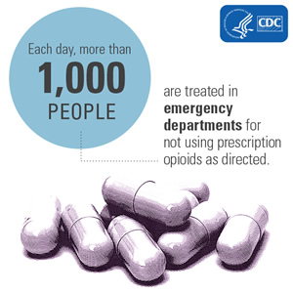
NATIONAL SPOTLIGHT
Substance Abuse and Mental Health Services Administration. Highlights of the 2011 Drug Abuse Warning Network (DAWN) findings on drug-related emergency department visits.
The DAWN Report. Rockville, MD: US Department of Health and Human Services, Substance Abuse and Mental Health Services Administration; 2013.
Available from URL: http://www.samhsa.gov/data/2k13/DAWN127/sr127-DAWN-highlights.htm

Slide 6
US makes up 4.6% of the world’s population, but consume more than 80% of the opioids worldwide
In 2014, almost 2 million people abused or were addicted to prescription opioids
As many as 1 in 4 people who receive prescription opioids long term for noncancer pain in primary care settings struggles with addiction
In 2016, the pharmaceutical industry will realize $15.3 billion in revenue
Substance Abuse and Mental Health Services Administration, National Survey on Drug Use and Health, 2014.
Boscarino JA, Rukstalis M, Hoffman SN, et al. Risk factors for drug dependence among out-patients on opioid therapy in a
large US health-care system. Addiction 2010;105:1776–82. http://dx.doi. org/10.1111/j.1360-0443.2010.03052.x

Slide 7
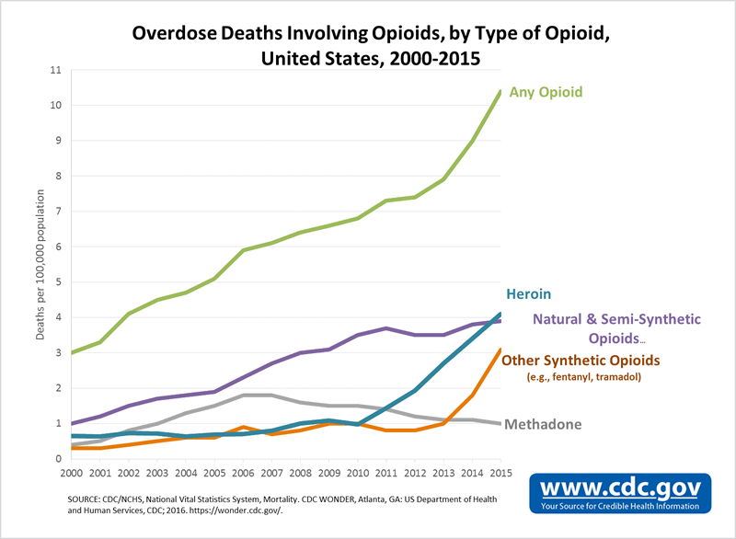

Slide 8
Audience Response
Is the current US opioid crisis a major problem where you live?

Slide 9
What Else Has Driven Change?
ERAS
Length of Stay (LOS)
http://erassociety.org/

Slide 10
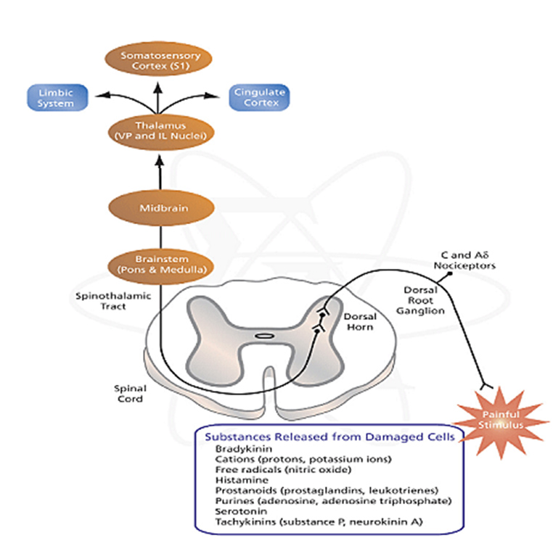
Understanding Pain Transmission
Yale Journal of Biology and Medicine 1993
Notes:
Postoperative pain is a consequence of tissue injury, nerve irritation and the resulting cascade of neurhumeral events that follow. After a painful stimulus, chemical mediators such as prostaglandins (PGE2) and bradykinin are released at the site of tissue injury. These chemical mediators stimulate nociceptors, peripheral pain receptors that respond to trauma and high temperatures. These nociceptors for pain fibers that enter the spinal cord via the dorsal root ganglion.

Slide 11
Pain Cascade
SNS
Incr NE, epi → HTN, HR, ischemia
Endocrine
Decrease Thyroid
Incr Aldosterone (renin/angiotension)
Water/sodium retention
Pituitary
GH, Vasopressin
Inflammation
Metabolism
Incr glucagon, Decr insulin leading to lipolysis, hyperglycemia
prot catabolism, wound inf.
Heme changes
Hypercoagulable (dvt prophylaxis)
Immune system
Cytokine production
TNF
Leukocyte release
Yale Journal of Biology and Medicine 1993
Barash 5th edition

Slide 12
Consequences of Poor Pain Management
Myocardial ischemia
Pulmonary infections
Paralytic ileus
Urinary retention
Thromboembolisms
Impaired Immune functions
PONV
Anxiety
Prolonged hospitalizations
Patient dissatisfaction
The New York School of Regional Anesthesia (www.ysora.com) 2009. Multimodal Anesthesia in Hip and Knee Arthroplasty

Slide 13
Acute Tissue Injury May Lead to Chronic Pain

Slide 14
Cost of Chronic Pain
The annual cost to the national economy associated with chronic pain is estimated to be $560 to $635 billion. That is more than heart disease, cancer, and diabetes combined!
https://www.sciencedaily.com/releases/2012/09/120911091100.htm

Slide 15
Summary of Poor Pain Management
Emotional impairment
Physical impairment
INCREASE COST, RESOURCES, MORTALITY
New York School of Regional Anesthesia 2009

Slide 16
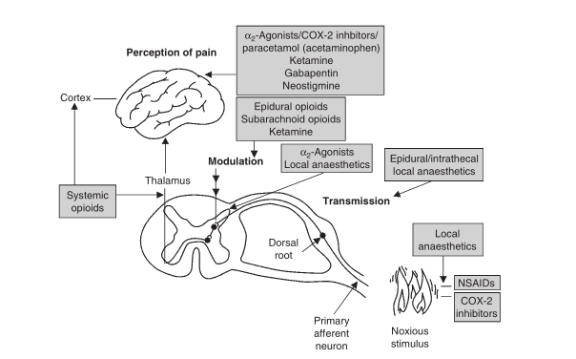
Pain Transmission Reference Picture

Slide 17
Adopting Multimodal Strategy
Pre-operative Period
Intraoperative Period
Postoperative Period

Slide 18
Pre-operative Time “Opioid Sparing Technique”
Tylenol
NSAIDS
COX-2
Anticonvulsant/Antineuropathics
MU receptor antagonist
Notes:
Use of non opioid drugs during the preoperative period can reduce excess intraoperative opioid usage and the possible subsequent effect of opioid induced hyperalgesia seen after surgery.
Opioid induced hyperalgesia is a complex phenomenon that can follow rapid escalation in opioids during or following surgical procedure which can paradoxically lower the pain threshold and result in greater opioid requirements

Slide 19
NSAIDS
MECHANISM OF ACTION

Slide 20
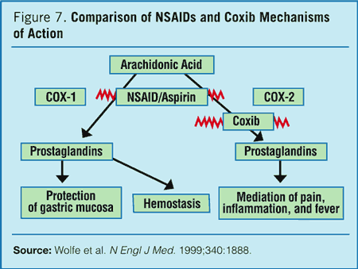

Slide 21
NSAIDS
Reduction of post-op pain scores, PONV, and opioid requirements
Better patient satisfaction
Inhibit prostaglandin synthesis and stimulation of nociceptors
DOWNSIDES: Surgeons concerned with platelet aggregation/increased bleeding time (7-10 days hold normally). Renal impairment, poor wound and bone healing, gastritis, peptic ulcer disease
Woolf et al. Anesthesia and Analgesia 1993
Kehlet et al. Anesthesia and Analgesia 2005

Slide 22
NSAID DOSAGE
Drugs | Dose | Route | Time before Surgery | Time after Surgery
Ketorolac | 15-30mg | PO/IV | 1-2 hr | 15-30mg q 6 hr
Ibuprofen | 800mg | PO /IV | 1-2 hr | 800 mg q 6 hr (don’t exceed 4200mg)

Slide 23
COX-2 Selective Inhibitors
MECHANISM OF ACTION

Slide 24
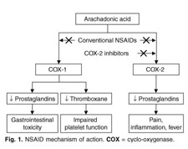
Mechanism of Action

Slide 25
COX-2 Selective Inhibitors
More popular due to unpopular side effects of NSAIDS
Selective inhibition of prostaglandins (reduction of bleeding and gastric side effects)
Dose on empty stomach
Studies: one hour (some 24hr) before surgery dose - significant reduction in post-op pain scores compared to placebo 1hr, 2hr, and 24hr after surgery
Lower opioids, faster time to rehab, lower PONV, better sleep, better pt satisfaction
DOWNSIDES: Potential increased risk of cardiovascular risks with long term use (not with short term use)
Rofecoxib withdrawn from market
Reuben SS et al. The preemptive Analgesic Effect of Rofecoxib after ambulatory Arthroscopic Knee Surgery. Ambulatory Surgery, 2002.
Buvandendran A, et al. Effects of perioperative administration of a selective cyclooxygenase 2 inhibitor on pain management and recovery of function after knee replacement. Jama, 2003.
Reuben SS et al. Postoperative analgesic effects of celecoxib or rofecoxib after Spinal fusion surgery. A&A. 2000.

Slide 26
COX-2 DOSAGE
Drugs | Dose | Route | Time before Surgery | Time after surger
Celecoxib | 400mg | PO | 1 hour | 200mg x 1 2 hrs after surgery
Valdecoxcib | 40mg | PO | 1 hour | BID

Slide 27
Anticonvulsants
MECHANISM OF ACTION

Slide 28
Anticonvulsants
Aka “antineuropathic” ; traditionally used for seizures and neuropathic pain
Inhibit central neuronal sensitization
Reduces post-op pain, opioid consumption & opioid side effects, and enhanced outcomes (knee motion)
Synergism with COX2
Rose at al. Anesthesiology. 2002
Dierking et al. Acta Anaesthesiol Scand 2004

Slide 29
Anticonvulsants Dosage
Drug | Dose | Route | Time before surgery | Time after surgery
Gabapentin | 1200mg | PO | 1-2 hours | 1200mg x 1 (24 hrs after surgery)
Pregabalin | 150mg | PO | 1 hour | 150mg x 1 (12 hrs after surgery)

Slide 30
Acetaminophen
MECHANISM OF ACTION
Unknown, but we think
Notes:
Mechanism of Action. The exact mechanism by which acetaminophen produces its analgesic and antipyretic effects remains undefined. The primary mechanism of action is believed to be inhibition of cyclooxygenase (COX), with a predominant effect on COX-2

Slide 31
Acetaminophen
Used for decades
IV Tylenol 2002 in Europe / 2010 in US
Can be used pre-op, intra-op, post-op (studies support benefits at all time periods)
Lower VAS (visual analogue score), lower morphine and opioid consumption, and shorter stay in PACU
Has shown to enhance fast-tracking patients to phase II (Ender, et al).
Oral administration of Tylenol can probably achieve the same results as IV Tylenol (Buvanendran et al).
More rapid IV
Synergism with NSAIDS (much better together)
DOWNSIDES: contraindicated in patients with liver disease
Ender et a. Anesthesiology..

Slide 32
Acetaminophen
Wininger et al. Clin Ther 2010.

Slide 33
ACETAMINOPHEN DOSAGE
Drug | Dose | Route | Time before surgery | Time after surgery
Acetaminophen | 600mg-1000mg | PO/IV | 15 minutes | Q 4-6 hr (not to exceed 4000mg in 24 hr)

Slide 34
INTRAOPERATIVE ANALGESIA

Slide 35
NMDA Antagonists
MECHANISM OF ACTION

Slide 36
NMDA Antagonists
Ketamine / Memantine
Induction bolus and intraoperative infusion
Studies: reduction in opioid consumption
Decreased incidence of chronic pain
DOWNSIDES: ketamine – memory deficits; schizophrenia
Remerand et al. Anesth Analg 2009
Loftuset al. Anesthesiology 2010

Slide 37
NMDA Antagonists
Magnesium
Inhibition of calcium influx, antagonisim of NMDA receptors and prevention of enhanced ligand-induced NMDA signaling
Attenuate central sensitization after peripheral tissue injury or inflammation because of dorsal horn NMDA receptors
50mg intrathecally effective; “high doses” IV reduce opioid consumption but not pain scores
Further investigation recommended
Remerand et al. Anesth Analg 2009
Loftuset al. Anesthesiology 2010

Slide 38
NMDA ANTAGONIST DOSAGE
Drug | Dosage | Details
Ketamine | 5-6 mcg/kg/min IV 0.25 – 0.5mg/kg bolus optional before incision IV | Stop post op
Magnesium | 50mg intrathecally 2g-4g IV | Stop post op

Slide 39
Alpha 2 Agonists
MECHANISM OF ACTION

Slide 40
Alpha 2 Agonists
Decreased opioid consumption, PONV and PACU stay
Can be added to regional anesthesia
DOWNSIDES: Additional doses of phenylephrine and ephedrine needed intraoperatively
Lena et al. Journal of Cardiothoracic and Vascular Anesthesia

Slide 41
ALPHA 2 AGONISTS DOSAGE
Drug | Intra-op Dosage | Route | Time before surgery | Time after surgery
Dexmedetomidine | 0.5mcg/kg/hr Bolus? | IV | n/a | n/a
Clonidine* | 150 mcg | PO | 1.5 hr before | n/a
Notes:
ADD INTRA OP DOSAGE TO ALL TABLES***************

Slide 42
Regional and Local Anesthesia
MECHANISM OF ACTION

Slide 43
Regional and Local Anesthetics
Regional when possible and when indicated
Lidocaine infusions have shown to decrease LOS PACU, opioid consumption, and enhance overall recovery time
Contraindicated in 1st degree and 2nd degree AV block. Allergy to amide locals.
Liposomal bupivicaine (Exparel). Lasts up to 72 hrs. Do not exceed 266mg
Gandhi et al. Journal of New York School of Regional Anesthesia 2009.

Slide 44
LOCAL ANESTHETICS DOSING
Drug | Dose | Details
Lidocaine | 2mg/kg/hr Bolus? 1.5mg/kg | Stop at end of surgery
Regional as indicated | n/a | n/a

Slide 45
PACU Stay
Top Predictors of increase LOS in PACU?
Pain and PONV
(Journal of Perioperative Medicine)
How much does one minute of PACU time cost? $8 / min
(www.anecare.com)
Notes:
OR is $65 / min

Slide 46
Decreasing PACU stay
Michaloliakou et al. Anesthesia & Analgesia
Notes:
(57.1%) vs (4.2%) in the control group (P < 0.001). Similarly, the severity of pain was sixfold less in the treatment group than in the control group. PACU was significantly less in the treatment group; 4.7% vs 29.5% Patients from the treatment group satisfied Postanesthesia Discharge Score significantly earlier than those in the control group (281 * 12 min vs 375 19 min; P < 005)

Slide 47
Prevents acute and chronic pain
50 patients for breast cancer surgery
Local, gaba, local cream
Analyzed patients in PACU, and home at
3, 6, 9hr
8 days
3 and 6 months
Treatment group in PACU in comparison to control
Lower visual analog scores (P=0.001)
Less acetaminophen (P<0.002)
Less narcotic (P=0.003)
Conclusion – multimodal analgesia reduced acute and chronic pain
Fassoulaki et al. Anesthesia and Analgesia 2005
Notes:
Fifty patients scheduled for breast cancer surgery were blindly randomized to receive gabapentin, eutectic mixture of local anesthetics cream, and ropivacaine in the wound or three placebos. Pain (visual analog scale) and analgesics were recorded in the postanesthesia care unit (PACU) 3, 6, and 9 h and 8 days after surgery. Three and 6 mo later, patients were assessed for chronic pain. The treatment group consumed less paracetamol in the PACU (469 versus 991 mg; P < 0.002) and less Lonalgal® (1.0 versus 4.4 tablets; P = 0.003) than the controls, exhibited lower visual analog scale scores at rest in the PACU (P = 0.001) and on postoperative Days 1, 3, and 5 (P = 0.040, P = 0.015, and P = 0.045, respectively), and after movement in the PACU (P = 0.001) and on postoperative Days 2, 4, and 8 (P = 0.028, P = 0.007, and P = 0.032, respectively). Three and 6 mo after surgery, 18 of 22 (82%) and 12 of 21 (57%) of the controls reported chronic pain versus 10 of 22 (45%) and 6 of 20 (30%) in the treatment group (P = 0.028 and P = 0.424, respectively); 5 of 22 and 4 of 21 of the controls required analgesics versus 0 of 22 and 0 of 20 of those treated (P = 0.048 andP = 0.107, respectively). Multimodal analgesia reduced acute and chronic pain after breast surgery for cancer.

Slide 48
Association between Multimodal and Periop care
Treatment: 149 ENT surgical patients celecoxib, gabapentin and tramadol
Control: 204 conventional narcotic technique
Conclusions:
PACU stay reduced by 22 minutes
Less narcotic intraop and in PACU
Vu et al. JAMA Otolarngol Head Neck Surg 2020 ; 146(8). 708-713

Slide 49
Multimodal Analgesia on Quality Recovery
140 patients randomized, prospective undergoing GYN procedure
Treatment – multimodal; Control – conventional opioid
Primary outcome: Quality of Recovery (QOR) score
Secondary outcome: numeric pain score, opioid consumption, clinical recovery, c reactive protein, adverse events
Conclusions/Results: numeric pain, opioid consumption, C-reactive protein, and rescue PONV meds lower in treatment group. Time to ambulation & bowel function were shorter. Patient Satisfaction scores higher
Geng et al. BMC Anesthesiology 2021

Slide 50
Thinking outside the box – Future?
Hypnosis
“mesmeric anesthesia” 1828
18 years before ether
Used in Europe
Faymonville et al. thousands of surgeries
“hypnosedation” with local anesthesia and mild sedation
Advantages: post op pain & recovery time
Hypnosis and anesthesia. Alchemyinstitute.com
PA society of Anesthesiologists 2017 Newsletter. Anesthesia non pharmacological and alternative therapies

Slide 51
Thinking outside the box – Future?
Music
Koch et al. two randomized trials
reduced amount of analgesia and sedation
Brandt et al improves anxiety
Koch. The sedative and analgesic sparing effect of music. Anesthesiology.
Brandt et al. Music Interventions for preoperative anxiety.
Notes:
Working out studies

Slide 52
Thinking outside the box – Future?
Aromatherapy
“essential oils” (lavender, chamomile, and orange)
Shown to reduce pre-op anxiety, induce sleep, and maintain stable BP in dental and cardiac stent insertion
GABA inhibition pathway (animal and clinical studies)
Peppermint, ginger and cardamom
Reduces PONV
Reduces antiemetic agents during ambulatory surgery, endoscopy, c-sections
Less compelling evidence for pain management
Eck & Green. PA Society of Anes Newsletter 2017. Anesthesia non pharmacological and alternative therapies.
Ni et al. Evidence Based Complementary and Alternative Medicine. 2013.

Slide 53
Conclusions
1. Multimodal analgesia perioperative management has advantages compared to traditional opioid based management
2. Multiple studies prove that multimodal analgesia decreases PACU and overall hospital LOS
3. Future research should consider including nonconventional therapy such as hypnosis or music therapy as part of multimodal anesthesia

Slide 54
Audience Response
What is your organization’s multimodal strategy?

Slide 55
Notes:
Hopefully, you are opening in trying to go down the new path of multimodal analgesia

Slide 56
Questions?

