Slide 1
The Business of Anesthesia: Understanding the Micro and the Macro Economics
Tracy Paul Young CRNA, MSNA, MBA

Slide 2
Objectives
Identify key components of the Microeconomics of Anesthesia (the Individual CRNA/Patient)
Identify key elements and players in the Macroeconomics of Anesthesia
Identify how to start an anesthesia business
Identify staffing options for Anesthesia departments
Anesthesia Trends and the future of Anesthesia

Slide 3
Microeconomics of Anesthesia
In its most basic form, the business of anesthesia is made up of a patient and an anesthesia provider

Slide 4
THE MICOECONOMICS OF ANESTHESIA
This clinical interaction is the foundation for all economic activity in the business of anesthesia
Every clinical decision made by the provider during this interaction has an economic impact downstream
Key decisions are:
The type of anesthetic chosen (General, Regional, MAC, Post-Op Block, Opioid sparing technique)
Which agents used to accomplish the anesthetic that was chosen (Sevo, Des, Iso, Lidocaine, Bupivicaine, Ropivicaine, Propofol, Etomidate, Succ, Vec, Roc etc. etc.)
How is Post-Op Pain treated?
Are you pre-treating for Post-op N&V (in all patients, in high risk only patients, or in no patients)
Are you correctly and accurately documenting the preoperative exam, the surgery, and any and all procedures performed

Slide 5
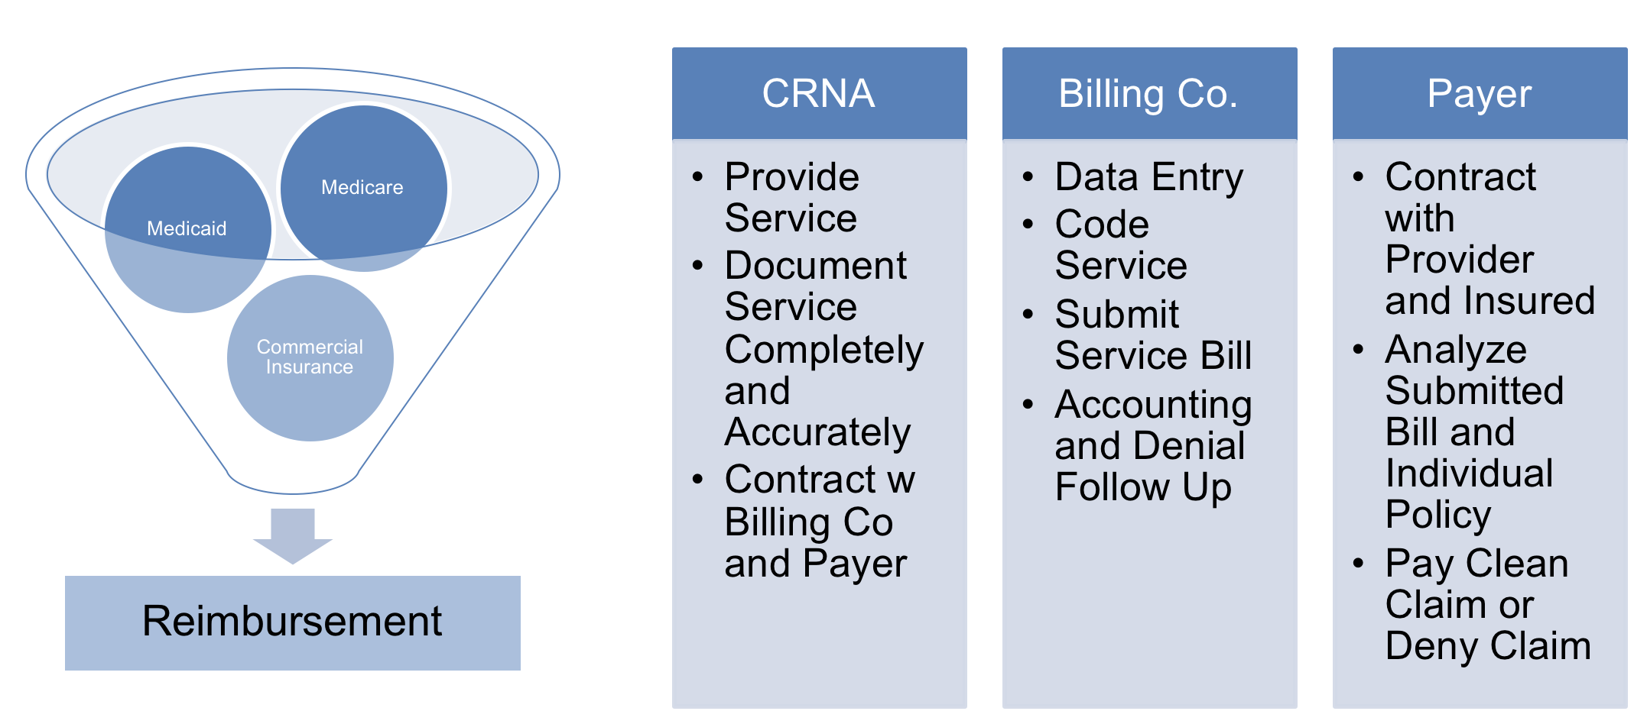
THE MICOECONOMICS OF ANESTHESIA Anesthesia Billing

Slide 6
THE MICOECONOMICS OF ANESTHESIA Anesthesia Billing
All Anesthesia charges are based on units
Every case has a base unit amount assigned to it
Base unit amounts are published yearly and are based on the complexity of the case and the expected workload of the anesthesia provider required to perform the case
Base units are constant and do not change unless changed in the yearly RVU guide
Base Units are then added to time units (each 15 minutes is 1 additional unit) and then any modifiers are added

Slide 7
THE MICOECONOMICS OF ANESTHESIA Anesthesia Professional Billing
Modifiers are any special conditions that affect the anesthesia care given.
After the base units are added to time units plus any modifiers then we multiply that number to the Conversion Factor to determine the billed amount.
Medicare publishes its conversion factors yearly and they are specific to the geographical location in which the service was rendered
Insurance companies negotiate a dollar per unit conversion factor with each anesthesia group/provider and this amount is typically contractually confidential

Slide 8
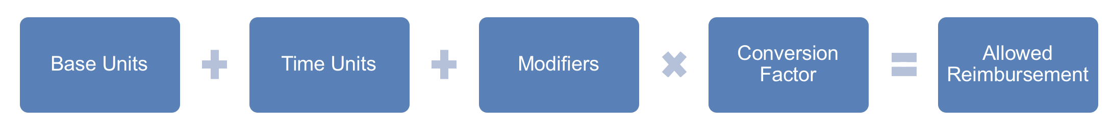
Group Exercise
Group 1: Calculate daily revenue for the following cases:
4 Lap Choles: CPT 00790, 7 Base Units, Each case 1.5 Hours of Anesthesia Time.
½ are Medicare at $22/unit and ½ are Commercial at $58/unit
Group 2: Calculate daily revenue for the following cases:
12 GI Cases mix between EGDs and Colonoscopies: CPT Codes 00731, 00811, or 00812 for an average base units of 4.5 units/case and 30 minutes anesthesia time each.
Same Payer mix as above.

Slide 9

Group Exercise
Results:
Group 1: 7 base units/case x 6 time units/case = 52 units for the day. Times the average per unit allowable of $40/unit equals a $2,080 day in allowable reimbursement!
Group 2: 4.5 base units/case x 2 time units/case = 78 units for the day. Times the average per unit allowable of $40/unit equals a $3,120 day in allowable reimbursement!

Slide 10
The Microeconomics of Anesthesia The individual Anesthesia provider
All CRNAs work either as a W2 employee or a 1099 Independent Contractor.
Independent Contractor or Employee of Local MDA or CRNA Group
Independent Contractor or Employee of Large Regional or National Anesthesia Group
Independent Contractor or Employee of Hospital or ASC
Self Employed Independent Contractor to Multiple Sites with daily pay (typical Locums or PRN provider)
Self Employed fee for service (very few of these left)

Slide 11
The Microeconomics of Anesthesia The w2 employee
Most CRNAs are familiar with being a W2 Employee because of years working as an RN Prior to Anesthesia School
The term W2 comes from the IRS form for reporting income and wages for employees
CRNA’s could be Employees of Hospitals or ASCs, MDA Groups, CRNA Groups, the State or Federal Government depending on the hospital

Slide 12
The Microeconomics of Anesthesia The 1099 Independent Contractor
Common term for Independent contractor is 1099 because the IRS form used to report income for independent contractors is Form 1099
Independent Contractors are considered Self Employed by the IRS
In order to be an independent contractor an Employee/Employer relationship cannot exist
IRS uses the 20 Factor Test to help determine if you are an Independent Contractor or Employee (note: the 20 factor test is not an all or none test, most CRNAs fall somewhere in the middle based on the amount of control exerted by employer)
Many independent CRNAs form a small business for tax and liability reasons (LLC, S Corp, APMC, etc.)

Slide 13
Microeconomics of Anesthesia Pros and Cons of w2
PROS
Familiarity, taxes are withheld and are simpler to file at end of year
Employer pays half of Medicare and SS tax
Benefits are often provided: Health, retirement, mal practice, life and disability
State Employment law protections
CONS
Much harder to deduct “business” expenses
Harder to change jobs since benefits are tied to specific job and not to you as a provider
Often slightly lower pay
Potentially less autonomy as employee/employer implies more direction/control

Slide 14
Microeconomics of Anesthesia Pros and Cons of 1099
PROS
Often paid at a higher rate
Often more autonomous environment
Able to make more aggressive tax deductions, deduct business expenses
Able to save more for retirement
Typically have your own Malpractice policy so picking up extra locums is easier
Could be more marketable/mobile as a 1099 since benefits are tied to you and not the job
CONS
Taxes are not withheld and subject to Self Employment Tax: all of Medicare/SS taxes
More complicated tax filing and quarterly payments
No Benefits, often cost more since not in a group plan
No matching retirement funds
Less legal protections if terminated i.e. no cause needed and state employment law often does not apply

Slide 15
Microeconomics of anesthesia The Anesthesia Provider
A few quick slides that may help some of you in your anesthesia career
Guide to a well written CV
When and how best to negotiate
Keys to long term success in anesthesia

Slide 16
Microeconomics of Anesthesia Guide to a Well Written CV
Be concise, be concise, be concise
Needs to look professional
State your name and contact information clearly
Education background with dates and degrees
Work history with dates and basic duties
Any special skills or details that you think would be pertinent
Be concise!
* A quick note about social media*

Slide 17
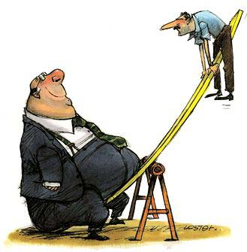
Microeconomics of Anesthesia Negotiation and Leverage

Slide 18
Microeconomics of Anesthesia The Art of Negotiating
Be professional and courteous
It could cost you the job if not
You will have to work with your boss after these negotiations
Be patient
Some decisions may have to go through multiple channels for approval
While it’s a huge deal for you, your boss may be dealing with many other huge deals and it may take some time to get an answer
Be well informed
Know your value and what special skills, attributes, knowledge that you bring to the job (multilingual, proficient at regionals, customer service oriented, etc.)
Know what is negotiable: salary, benefits, call pay, time off etc.

Slide 19

Microeconomics of Anesthesia Keys to long term career satisfaction
Be affable, amicable and available
Learn to strike a balance between work, family and play
Embrace challenges
Avoid negativity (stay above the OR gossip)
Don’t bring personal problems to work
Seek a job that fits your skills and personality (not just pay)
Always look at being a CRNA as a privilege!!!

Slide 20
Macroeconomics of Anesthesia

Slide 21

Macroeconomics of Anesthesia
The macroeconomic environment of anesthesia can considered everything and anything beyond the provider/patient interaction
Todays focus, will be on the different types and sizes of anesthesia groups
“Mom and Pop” or Local groups
Regional/Midsize Anesthesia companies
Large National Anesthesia or Multispecialty Groups

Slide 22
Macroeconomics of Anesthesia The Local or “mom and pop” Group
This group is typically owned by a provider (CRNA or MDA)
Occasionally may have a non clinical owner
Typically has one or two facility contracts in a relatively small geographical area
The owners are very hands on for day to day management
If the owners are clinicians they typically provide much of the clinical workload themselves and plenty of direct oversight

Slide 23
Macroeconomics of Anesthesia The local “mom and pop” Group
PROS
The decision making process is streamlined
Often develop close relationships with owners
Can allow for more flexibility because often no defined set of corporate rules
The owners often have very close relationships with admin and other stakeholders, surgeons, etc
CONS
The decision is often final and without appeal
Financial stability could be an issue during lean times
Often poorer third party payer contracts due to lack of leverage
Susceptible to take over from larger groups with more financial and staffing resources

Slide 24
Macroeconomics of Anesthesia The “regional/midsize” Group
These groups are either owned by clinicians or non-clinician business owners
They typically operate in a larger geographical area (all across a state or several states)
Often provide services to 10-50 facilities and have upwards of 500 providers
The owners are often less involved in day to day management and more focused on strategic vision
Typically are not financed through private equity

Slide 25






Macroeconomics of Anesthesia The “regional/midsize” Group

Slide 26
Macroeconomics of Anesthesia The “regional/midsize” Group
PROS
Often more nimble than national groups
Often only small layer between owner/CEO and provider
Often more financially stable than local group
More resources when it comes to staffing flexibility
Better negotiated rates with payers
Often have clinical protocols to fall back on and solid PI/QI programs
CONS
May have to go through several layers of management to get things done
Leadership may loose touch with individual providers
Relationships with admins may not be as strong as local groups
Contracts often become more financially motivated and less relationship motivated
Service may suffer if leadership is not hands on

Slide 27
Macroeconomics of Anesthesia The “national/multispecialty” Group
The large national anesthesia or multispecialty group can be owned by clinicians, non-clinicians, private equity firms or be publicly traded companies
They typically operate across a large geographical area of many states or the entire United States.
They typically provide services to well over 100 facilities and have several thousand providers
Private equity has made a large push into anesthesia in the last decade and has fueled many recent acquisitions which is leading us toward an increased market consolidation

Slide 28




Macroeconomics of Anesthesia The “national/multispecialty” Group
Notes:
Emcare is multispecialty
TPG capital just bought majority interest in Northstar (600 providers) but TPG funding will generate rapid expansion through other acquisition
Sheridan, click to link later for details of amsurge deal

Slide 29
Macroeconomics of Anesthesia The “national/multispecialty” Group
PROS
Typically well funded and well organized
Often have the ability to work in numerous locations nationwide within the same system
Often have strong clinical guidelines and protocols
Many resources to call upon for staffing
Best payer rates with insurance companies
Typically have fairly good benefit structures
CONS
Potential funding issues due to rapid growth/acquisitions (see AHP)
Individual providers can sometimes feel like a “warm body”
Many many layers between CRNA and top management
The desire to increase the bottom line or EBITDA can lead to clinical practice issues as shareholder demand earnings estimates to be made
Owners are often nameless and faceless

Slide 30
Macroeconomics of Anesthesia The Sheridan Case study
Started over 60 years ago as a small Florida based Anesthesiologist company
Sheridan was acquired by Private Equity company Hellman & Friedman in 2007
Then it was bought by Amsurg for $2.4 billion in cash and stock in 2014
Amsurg and Envision merge in 2016, combined revenue of $8.5 billion per year and branded as Envision Physician Services
Envision Physician Services is bought and taken private again by Private Equity giant KKR for $10 billion in June 2018

Slide 31
Macroeconomics of Anesthesia What is Private Equity, EBITDA and Multiples
Private Equity is playing a large role in the macroeconomics of anesthesia in the past 10-15 years
Private Equity is an asset class of securities and debt in a company that is not traded publicly. Typically the investment is made by a private equity firm, a venture capital (VC) firm or an angel investor (Shark for those who watch Shark Tank)
EBITDA or Adjusted EBITDA is one of the primary metrics looked at by PE or VC firms when looking to invest in any Business
EBITDA is Earnings Before Interest, Taxes, Depreciation and Amortization (Adjusted EBITDA is an adjustment made for any special circumstances within the business that would affect the new owners)
Multiples are an amount of EBITDA that an investor is willing to pay for an Equity Stake in a company
The multiple that someone or some firm is willing to pay is determined by many factors including but not limited to: Size of the company, time company has been in business, location, stability, growth potential, current and future market factors, leadership etc. etc.

Slide 32
The Business of Anesthesia 101
How to Get Started

Slide 33
The Business of Anesthesia 101 Entity Selection
The first step in getting started in the Business of Anesthesia is to decide on a name and then to determine what type of entity to create and how to create it.
Sole Proprietorship
A one-person business that is not registered with the state. You create one just by going into business for yourself, no paperwork required. Largely, sole proprietorships are inseparable from its owner and reports all income and losses on the owner’s personal income tax return. The owner is personally responsible for all debt, liabilities and court judgments. Not recommended for CRNAs!

Slide 34
The Business of Anesthesia 101 Entity Selection
Limited Liability Company (LLC)
An LLC is slightly more difficult to create. Requires registering with the Secretary of State and creating an EIN with the IRS. The process takes 30 minutes or less typically.
Forms required are: Articles of Incorporation/Articles of Organization. These just state the nature of the business, Registered Agent of the business, and any members and managers of the business. Highly recommended that an OA be drafted otherwise the state business law will apply to any conflicts.
The main benefit of an LLC is that it limits the owner’s personal liability from debts and court judgments.
The IRS considers LLCs as a “Pass Through Entity” in that an LLC must file a federal tax return but the LLC does not pay any federal taxes
All the taxes are paid by the owner’s share of income on their personal tax return

Slide 35
Business of Anesthesia 101 Entity Selection
Corporation (Inc)
Corporations provide similar limits to liability to LLCs but are slightly more arduous to create and to maintain.
Just like an LLC, Articles of Incorporation need to filed with the Secretary of State but Corporations are also required to create “Corporate Bylaws” and issue stock certificates to the owners/shareholders of the business
Once up and running, annual shareholder and director meetings need to be held with minutes kept, and regular directors meetings held with minutes also
Corporations must file taxes and pay taxes on any profits that are left in the business after paying out all salaries, bonuses, expenses and other overhead.
US Corporate tax rates before 2018 started at 15% for the first $50,000 and toped out at around 35% for $10M and above. Currently we have a 21% flat corporate tax rate
At 35%, the US had the highest nominal corporate tax rate in the developed world until recent tax reform and now we are in the average for the developed world economies.
Notes:
Who pays corporate taxes?

Slide 36
Business of Anesthesia 101 What next? Marketing/Strategic plan
Now that you have an entity and a name chosen, who are you and what do want to accomplish?
What is your Core Philosophy/Mission Statement?
Marketing/Branding based on your Mission Statement
What are your differentiators?
What are your Core Competencies?
How do you Market your new company? (Hire a business development team or do it yourself, internet presence, trade shows, social media, cold calls, word of mouth growth….)
Develop a Strategic Plan and periodically review and revise based on current market analysis and future trends in healthcare

Slide 37
Business of Anesthesia 101 Individual Contract Evaluation
Now that you know who you are and what you want to accomplish, you need to learn to evaluate individual contracts:
Learn how to build a Pro Forma
Know the different types of Anesthesia Contracts
Determine Capital needs and source of Capital
Billing options available

Slide 38
Business of Anesthesia 101 Pro Forma
A Pro Forma is method of calculating financial results from current or projected data
A Pro Forma evaluates all revenue and expenses then will project a net profit or loss
A good Pro Forma relies on good data in and good formulas to produce a reliable and predictable outcome
Ideally you want as much data from the facility as possible about the cases done in the past year and projected cases for current year
You then need to evaluate that data and accurately project the income you expect to receive from performing those anesthetics
Next you figure out what your total expenses are and then compare for a profit analysis

Slide 39
Business of Anesthesia 101 Pro Forma Revenue
Data needed for Revenue calculations:
Need total case volume (past and/or projected)
Need case mix percentage (General Sx, Ortho, ENT, GI, OB etc)
Need Payer mix percentage (Medicare, Caid, BCBS, United etc)
Performing the calculations (simple version)
Take each case type and assign an average anesthesia unit amount to it, then multiply that by your weighted average reimbursement per unit
Determine the average reimbursement per unit by inputting the per unit value from each payer and then average them based on percent of total cases of each payer

Slide 40
Business of Anesthesia 101 Pro Forma Expense
Goal is to calculate as close to possible what your actual expenses will be. Expenses are made up following items:
Clinical Providers (CRNAs and MDAs mostly), Determine the amount needed based on concurrent case information, first starts, on call requirement, call backs, ratio of MDA to CRNA based on hospital bylaws, facility preferences and billing factors, vacation relief for providers, etc
Overhead such as malpractice insurance, worker comp, fringe benefits, cyber policy, administrative cost, any equipment, and cost to collect or billing expenses
Other cost of doing business (taxes, fees, audits, law suits etc)
Then evaluate expected loss or profit margin

Slide 41
Business of Anesthesia 101 Sample Pro Forma
Revenue
2500 cases per year
500 Ortho= $250k
500 GenSx= $200k
500 OB/Gyn=$200k
500 ENTSx= $150k
500 GIEndo=$100k
Total Revenue= $900k
Expense
Model 1MDA 3CRNA
1 MDA+vac= $400k
3 CRNA+vac= $650k
Billing= $ 60k
Mal Practice= $ 50K
Overhead= $ 40K
Total Expenses= $1,200

Slide 42

Business of Anesthesia 101 Oh No!

Slide 43
Business of Anesthesia 101 Types of Contracts
There are three main types of Anesthesia Contracts
Straight Fee for Service
Fee for Service with a Subsidy (fixed or floating)
Management Contract

Slide 44
Business of Anesthesia 101 Straight Fee for Service
Pros
Shared risk between Anesthesia and Facility
Stability since your service is not costing the facility anything
Motivated to increase surgical volume and efficiency
Cons
Shared Risk, no guarantee that you will be profitable
Market conditions change
Reimbursement reductions
Changes in Medicare rules and regs

Slide 45
Business of Anesthesia 101 Fee for Service w Subsidy
In this model, the anesthesia group performs just like in the fee for service but the facility makes up for any potential losses with a subsidy payment to the anesthesia group.
Subsidies can come in many different shapes and sizes. Call stipend, income guarantee, medical directorships etc. Bottom line is that the facility is subsidizing the anesthesia department.
The subsidy is typically either floating or fixed.
Floating stipends vary with the collections on the fee for service side. This is also called a “Net of Collections” model
Fixed stipends are regular payments made in the same amount to an anesthesia group to subsidize the department.

Slide 46
Business of Anesthesia 101 Fee for Service w Subsidy
Pros
Minimum Anesthesia revenue is guaranteed, zero loss if pro forma was accurate
Not dependent on the hospital/surgical volume to makes ends meet
Reimbursement changes don’t have direct affect on bottom line
Cons
Hospital on hook to meet your cost
They may question your ability or desire to maximize income through collections
They are reminded monthly that they are subsidizing anesthesia and thus have to remind them regularly of the value you bring to the facility
Profit margins are potentially smaller

Slide 47
Business of Anesthesia 101 Management Contract
An Anesthesia Services Management contract can take on many forms. As the name implies, the Anesthesia company is contracted to manage an anesthesia service. Often the management company provides back end support such as billing, recruiting, vacation relief etc for a management fee.
A recent trend has been for physician owned centers to see anesthesia as another service line that they can own and profit from but do not want manage.
This is more common in Surgery Centers and Endoscopy Centers
There could be some regulatory and legal concerns with some of these arrangements (Stark Law, AKS, Physician Self Referral, State Medical Practice Acts etc)

Slide 48
Business of Anesthesia Capital/Financing
Every business needs a source of capital to grow and pay its bills. Anesthesia is no different.
Depending on the type of contract that is set up and the size of the contract, the capital needs could be minimal or they could easily be 7 figures.
A cash flow analysis will be needed to see how much capital is required to start a new contract. Billing revenue is notoriously slow to start coming in with any new contract due to the bureaucracy of government and private payers.
A good rule of thumb is that you will need 3-6 months of expenses in order to finance a new contract depending on lead time.

Slide 49
Business of Anesthesia 101 Capital/Financing
There are numerous option when it comes to financing a start up
Many companies self finance either through cash reserves or rolling AR. (preferred method in my opinion) But start ups have done everything from a second mortgage on the owners home to using inheritance from a rich Uncle!
Local bank small business loans are another option
A Line of Credit at your bank is typically another good source
SBA, state or federal business loans
An angel investor who will invest in you for a stake in you company
Private equity money. PE is interested in medium to larger companies that are well established but need capital to grow through acquisition and mergers. The PE firm infuses capital with idea of growing EBITDA and in return get a stake in the company

Slide 50
Business of Anesthesia 101 Billing
Anesthesia billing is unlike any other specialty. Understanding and learning the ins and outs of anesthesia billing is very complex and can take years to fully understand due complex policies from third party payers.
For the purposes of this lecture the decision becomes to outsource or to do in house billing?
There is no right or wrong answer but both methods have pros and cons…

Slide 51
Business of Anesthesia 101 Outsource Billing
Pros
You get a company that is an expert in anesthesia billing
You don’t have to hire a staff to bill and collect for you
You don’t have to buy computers/software/desk/chairs/lease, buy or build and office
You don’t have to manage all the personnel in the billing department
Cons
You don’t control the process or operations of the billing department
You are relying on someone else to collect for you and to have the same passion that you would
Whatever fee they charge you to bill has a profit for them built in
It’s not easy to change billing companies as you grow

Slide 52
Business of Anesthesia 101 Outsource Billing
There are some things that a good billing company will do for you and do well
Send out clean claims
Vigorously fight any denials
Credential/Link all providers with third party payers
Assist with negotiating rates from third party payers
Help educate providers on proper documentation
Provide detailed monthly AR reports
Provide Ad Hoc reports as needed
Grow with you as you grow

Slide 53
Staffing an Anesthesia Department

Slide 54
Anesthesia Staffing Options
THERE ARE SEVERAL DIFFERENT ANESTHESIA STAFFING MODELS USED THROUGHOUT THE UNITED STATES.
MD ANESTHESIA ONLY
CRNA ANESTHESIA ONLY
TEAM APPROACH TO ANESTHESIA
(CMS and some Insurers pay the same way and amount for CRNA and MDA)

Slide 55
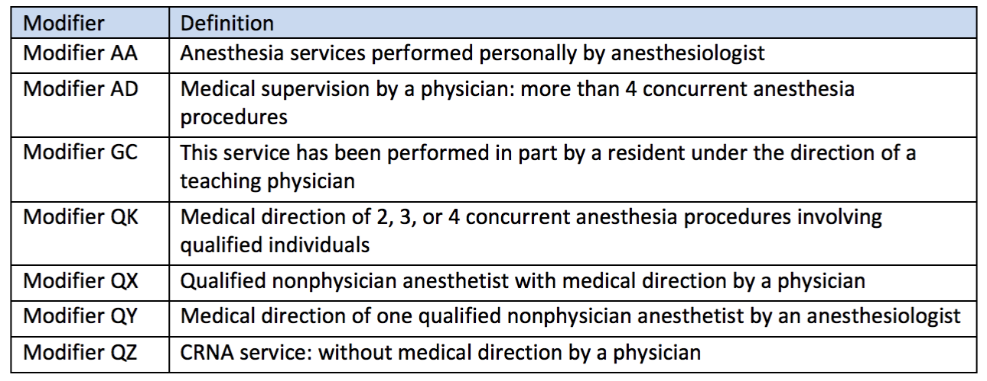
Anesthesia Modifiers

Slide 56
Tax Equity and Fiscal Responsibility Act, 7 Criteria for Medical Direction
Perform a Pre-anesthetic evaluation and examination
Prescribe the Anesthetic Plan
Personally participate in the most demanding aspects of the case including induction and emergence of anesthesia
Ensures that any procedure not performed by the MDA is performed by a Qualified Anesthetist
Monitors the course of the anesthetic at frequent intervals
Remains physically available for immediate treatment and diagnosis of emergencies
Provides indicated post op anesthesia care

Slide 57
Anesthesia Staffing Options
How does one determine what model works the best?
First, look at what the facility demands are for anesthesia (Cadillac option)
Second, look at what the facility is willing to pay for (Pinto?)
Third, what is the most operationally efficient model
Fourth, does the case load/payer mix support this model
Fifth, what are the facility bylaws related to anesthesia staffing
Sixth, is the MEC willing to change the bylaws to support the proposed model
So, what does the future look like for anesthesia staffing you ask???

Slide 58

Anesthesia Staffing Trends of the Future

Slide 59

Anesthesia Staffing Trends of the Future

Slide 60
Anesthesia Staffing Options The Future
The future of anesthesia is you! As budgets are squeezed tighter and tighter, every entity is looking at the safest and most efficient option to deliver care.
We finally have the studies to back up that we are the safest and most cost efficient option in anesthesia delivery.
Health Affairs: No harm found study
IOM: The Future of Nursing Report
Nursing Economics: Cost Effective Analysis of Anesthesia Providers
Are we prepared for the increased role and the increase autonomy that we are poised to see in the future?

Slide 61
Anesthesia Staffing Options The Future
Anytime the role of CRNAs is increased, expect push back on several levels.
This process often takes education of nursing staff, surgical staff, administrators and often even other CRNAs and MDAs.
The CMS Conditions of Participation (CoP) is the go to resource for facilities. It defines what an anesthesia department must do in order for the facility to participate in government programs (Medicare)
http://www.ecfr.gov/cgi-bin/text-idx?SID=d0190cd7dcc5f19e548c8519b65c2720&node=42:5.0.1.1.1.4.4.2&rgn=div8

Slide 62

Other Future Trends in Anesthesia
Increased market consolidation through M & A activity
Continued drug shortages
Very few new pharmaceuticals introduced
Increased reliance on government payers
Increased integration of technology in patient care

Slide 63

Thank you!
Tracy P. Young CRNA, MSNA, MBA

