Slide 1
Local Anesthetic Systemic Toxicity Thomas Baribeault DNP CRNA @BaribeaultOFA

Slide 2
Introduction
“Anesthesia is the art of the giving just the right amount of poison so that the patient survives being close enough to dead that they didn’t notice getting cut open.”

Slide 3
Local Anesthetics
Local anesthetics (LA) bind to intracellular portion of the Na channel preventing nerve depolarization
Lack many of the side effects of typical anesthetic agents
Respiratory depression
PONV
Immune suppression
Cardiac and Neurologic depressants

Slide 4
Complications
LAST
Cardiac and neurologic
Allergic or anaphylaxis
Esters
Methemoglobinemia
Prilocaine, Benzocaine
Neural, muscle, or tissue toxicity

Slide 5
LAST Causes
Excessive dose
Accidental vascular injection
Rapid Absorption
Factors that affect free plasma concentration
Decreased protein level
Acidosis
Liver or kidney failure
Ability of body to deal with LA
Heart failure

Slide 6
LAST Causes
Rapid Absorption
IV
Tracheal
Intercostal
Caudal
Paravertebral
Epidural
Brachial plexus
Spinal
Sciatic/Femoral

Slide 7
LAST Causes
LA toxicity
Lidocaine
Mepivacaine
Ropivacaine
Bupivacaine

Slide 8
LAST Causes
LA max dose
Lidocaine 5 mg/kg
1.6 mg/kg/hr
Mepivacaine 5 mg/kg
Ropivacaine 3 mg/kg
0.4 mg/kg/hr
Bupivacaine 3 mg/kg
0.4 mg/kg/hr

Slide 9
LAST Signs
40% of reported cases present atypically
Neurologic
Generally appear before cardiac
Exception bupivacaine
Pre-medication can mask signs
LA blocks inhibitory pathways in cerebral cortex leading to unopposed excitatory changes

Slide 10
LAST Signs
Neurologic
Early
Lightheaded/dizzy
Tinnitus
Metallic taste/circumoral numbness
Middle
Shivering/tremors
Myoclonus/tonic clonic convulsions
Disorientation
Late
Seizures

Slide 11
LAST Signs
Cardiac
Low plasma concentration of LA
Increased CO, BP, HR
High plasma concentrations of LA
Vasodilation
Decreased contractility
Dysrhythmia
prolonged PR, heart block, sinus arrest
Widened QRS leading to v-fib

Slide 12
LAST & Acidosis
Hypercarbia/acidosis increases LAST effects
Increased cerebral blood flow
Increased LA to brain
Decreased protein binding
Increased free plasma concentration
Intracellular acidosis
Ion trapping causes LA to stay intracellular in tissue

Slide 13
LAST Prevention
Least toxic drug, lowest dose, least risky block
Slow incremental injection/aspirate 3-5 ml
Monitor ekg, pulse ox, bp minimum 30 minutes post block
Decrease dose for elderly and those with cardiac, hepatic, or renal dysfunction

Slide 14
LAST Prevention
Test dose???
Fentanyl 100 mcg
Drowsiness
Epinephrine 10-15 mcg
Hr increase 10 bpm or bp increase 15 mmhg
Unreliable in elderly, sedated, on BB
USGRA
Visualize your needle tip!!!

Slide 15
LAST Treatment
RECOGNITION
Get Help
Control Airway/hyperventilate
Seizures
Benzodiazepine
Use propofol with caution

Slide 16
LAST Treatment
ACLS - modified
Epinephrine 1 mcg/kg
No Vasopressin
Amiodarone
Not lidocaine
Avoid
Beta blockers
Calcium channel blockers

Slide 17
LAST Treatment
20% lipid emulsion
1.5 ml/kg bolus
Can be repeated 1-2x
0.25 ml/kg/min for 30-60 minutes
Can be doubled if ROSC but bp low

Slide 18
LAST Treatment
20% lipid emulsion
Lipid sink
Large intravascular lipid volume binds and inactivates LA
Lipid Flux
Local anesthetics inhibit cardiac metabolism of lipids

Slide 19
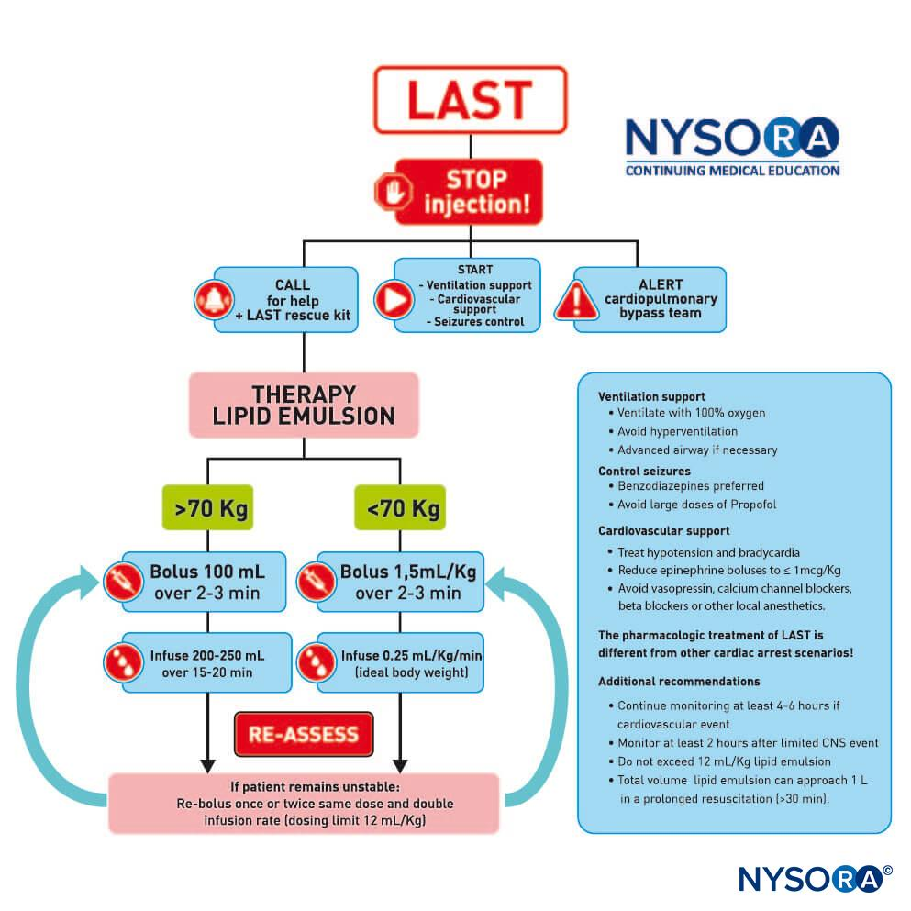
LAST Treatment

