Slide 1
Lipid Emulsion for Local Anesthesia Toxicity
Brian D. Berry Jr., CRNA, MBA, MS
System Chief Nurse Anesthetist &
Director of Perioperative Services
Excela Health
Adjunct Faculty
University of Pittsburgh
Pittsburgh, PA

Slide 2
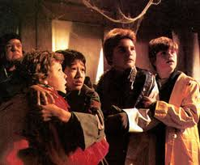

Slide 3
Audience Response
Has anyone in the audience experience Local Anesthesia Toxicity?

Slide 4
Objectives
Discuss and Review the pharmacodynamics/pharmacokinetics of local anesthetics
Differentiate between local anesthetics and their potential to cause local toxicity
Discuss the mechanism of action of local toxicity
Discuss current literature regarding lipid emulsion therapy

Slide 5
Pharmacodynamics
Locals have 3 basic components
Amine group
Aromatic group
Linkage group
Adding carbons =  lipophilicity, duration of action, and protein binding
Reversibly block conduction of impulses along central and peripheral nerve pathways (autonomic, somatic sensory and somatic motor)

Slide 6
LAs pharmacodynamics (cont)
Weak bases
Increased affinity for open Na⁺ channels and 75% of channels must be blocked for effect
H type alpha subunit binds to local anesthetics
a
α subunit
β subunit

Slide 7
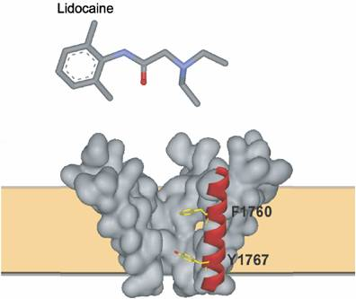
H α - Subunit

Slide 8
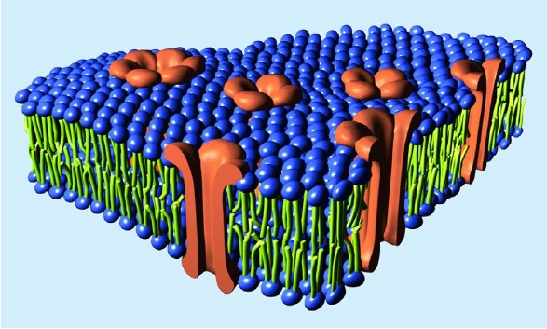
Na⁺ molecule
LA
LA⁺

Slide 9
Pharmacokinetics
Absorption, Distribution, Metabolism, and Excretion
Absorption influenced by site, dose, and use of epi
Redistribution from vessel rich group to vessel poor group
Amide LAs metabolized by CYP3A4.
Ester broken down my plasma cholinesterase
Renal excretion

Slide 10
LA | Potency | Onset | Duration of Action (min) | Max Dose (mg) | Max Dose (mg/kg)
Cocaine | 14 | Rapid | n/a | 200 | 1.5-3
Procaine | 1 | Slow | 45-60 | 500 | 8
Chloroprocaine | 4 | Rapid | 30-45 | 800-1000 | 10
Tetracaine | 16 | Slow | 60-180 | 100 | 1.5
Lidocaine | 1 | Rapid | 60-120 | 300-400 | 4-5
Prilocaine | 1 | Slow | 60-120 | 500 | 5-7
Bupivacaine | 4 | Slow | 240-480 | 150-175 | 1-2.5
Ropivacaine | 4 | Slow/Medium | 240-480 | 225 | 2.5-3
Levobupivacaine | 4 | Slow | 240-480 | 150 | 2-2.5
Etidocaine | 4 | Slow | 240-480 | 200-300 | 2-5

Slide 12
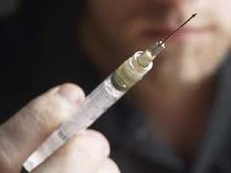
Toxicity
Good News…incidence has decreased
7.5-20 per 10,000 peripheral nerve blocks
4 per 10,000 epidurals
Toxicity most often to intravascular injection and not accumulation
Safety has ⬆ d/t
Aspiration
Knowledge (i.e. local toxic doses)
Divided doses
Test dose with epi

Slide 13
Factors influencing LA toxicity
Site
Speed
Total amount
Route
Remember- vasculature directly affects systemic absorption

Slide 14
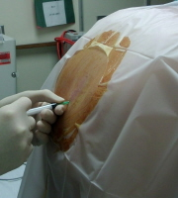
Toxicity (cont’d)
From increasing to decreasing order of absorption:
Inhalational/Intravenous
Intercostal
Caudal
Paracervical
Epidural
Brachial Plexus/Femoral
Spinal
Sciatic
Subcutaneous

Slide 15
Signs and Symptoms of Toxicity
Early – agitation, light headedness, altered mental state, vision Δ’s, slurred speech, HTN, ⬆HR
Moderate – CNS excitation, cardiac arrhythmias, contractile depression, conduction blockade
Severe - ⬇BP, ⬇HR, ventricular arrhythmias, seizures, cardiac collapse

Slide 16
Cardiac arrest
Respiratory arrest
Serum Concentration (μg/ml)
Coma
Unconsciousness
Muscular twitching
Visual and auditory disturbances
Lightheadedness
Numbness of Tongue
Signs and Symptoms of Local Toxicity

Slide 17
Physiology of Toxicity (cont’d)
LA binds to the Na⁺ in the heart (maybe on the Ca⁺⁺ and the K⁺ channels) inhibits cAMP.
Cardiac LA toxicity is very difficult to manage and treat
Resuscitation – well documented as very difficult
Bupivacaine is the most cardiotoxic of LAs.

Slide 18
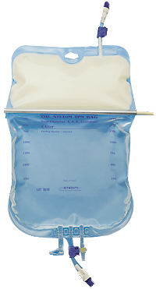
Lipid Emulsion
Discovered by Weinberg et al.
Components
20% soybean oil
1.2% egg yolk phospholipids
2.25% glycerin
water

Slide 19
 | Intralipid | Liposyn III | Medialipid | Clinoleic
Oils | 100% soybean oil | 100% soybean oil | 50% soybean oil and medium chain triglycerides | 80% olive oil and 20% soybean oil
Triglycerides (g/L) | 200 | 200 | 200 | 200
Phospholipids (g/L) | 12 | 12 | 12 | 12
Glycerol (g/L) | 22 | 25 | 25 | 22.5

Slide 20
Lipid Emulsion (cont’d)
Pharmacodynamics
“Lipid Sink” theory
Creates 2 compartments within the blood
Lipid Compartment
Aqueous Compartment
Lipophilic LAs are drawn into the lipid compartment or lipid “sink” portion of blood
⬇ LAs in the aqueous compartment of plasma
Pharmacokinetics
Lipolysis
Remaining particles to liver or internalized into endothelial cells

Slide 21
Local Anesthesia Injected in Blood
intravascular compartment

Slide 22
After Lipid Emulsion
Aqueous
Lipid

Slide 23
Lipid Emulsion Contraindications
Patients allergic to soybean protein, egg yolks, or egg whites
Individuals with compromised fat metabolism
No complications with Lipid Emulsion when administered to patient suspected to have local toxicity

Slide 24
Historical Perspective – how it came to be
Pt had a carnitine deficiency and was extremely sensitive to Bupivacaine
Carnitine is component necessary for transport of fatty acids into mitochondria
Fatty acids supply the majority of cardiac energy needs
Initial theory = Bupivacaine inhibits carnitine. Thus, decreasing fatty acid uptake
Pretreating with lipid infusion would potentiate cardiac arrhythmias

Slide 25
The Discovery
Accidental
Weinberg pretreated rats w/ infusion of lipids
Measured the dose of bupivacaine require to induce asystole
Rats that were pretreated were able to tolerate more bupivacaine
Rats that were pretreated were more easily resuscitated (survivability)
Weinberg et al., Anesthesiology, 1998

Slide 26
CARNITINE
Fatty Acids
Mitochondria

Slide 27
Bupivicaine
CARNITINE
Pretreat
Heart
Fatty Acids
Mitochondria
(arrhythmias)

Slide 28
Bupivacaine
CARNITINE
Pretreat
Heart
Fatty Acids
Mitochondria
(no arrhythmias)

Slide 29
Proving it worked - Dog Trial
12 dogs subjected to isoflurane anesthesia
Toxic Dose of bupivacaine given
After asystole occurred, cardiac massage for 10 minutes
6 dogs got lipids, 6 dogs got saline
Results: 6 dogs in lipid group converted to NSR in 5 minutes. After 30 minutes BP, HR, and ECG normal. 6 dogs in saline group never converted to NSR
Lipid therapy had a restorative effect on pH and 0² of myocardial tissue
Weinberg et al., Reg Anes Pain Med, 2003

Slide 30
Rat trial
1st part of Study
Bupivacaine infused to a final concentration of 500 μmol/L in the heart (asystole)
20% IVLE (intravenous lipid emulsion) was infused, buffer solution to control group
Findings
30% reduction in time to first heart beat in the lipid emulsion group
IVLE hearts had a faster return to 90% of their baseline rate pressure

Slide 31
2nd part of study
Bupivacaine was radiolabeled
Myocardial tissue samples from LV
before bupivacaine infusion
after bupivacaine infusion
30 seconds to 2 minutes thereafter
Bupivacaine was extracted from myocardial tissue
37 seconds for IVLE group
83 seconds for the control group
3rd part of study (no clinically significant data)
http://www.youtube.com/watch?v=b70Li9r3pL8
Weinberg et al., Reg Anesth Pain Med, 2006

Slide 32
(Case cont’d)
Total decreased 1.99 → 1.72 μg/mL
Protein unbound decreased 0.13 μg/mL → 0.05 μg/mL
BEFORE LIPID EMULSION
AFTER LIPID EMULSION

Slide 33
1st Human Case
58y male for right shoulder rotator cuff repair
Interscalene block with 20ml of 0.5% bupivacaine and 20ml of 1.5% mepivacaine
s/s of local toxicity ensued
CPR initiated (3mg epi, 2mg atropine, 300mg of amiodarone, 40u vasopressin, Defibrillation according to ACLS protocol)
30min into unsuccessful CPR, member of the code team suggested lipids
100ml of 20% lipid emulsion IV

Slide 34
1st Human Case Cont’d
360J defib, 1mg epi, 1mg atropine, 15 seconds pt in NSR
Lipids for 2hrs at 0.5ml/kg
2.5hrs later extubated, discharged following day
Successful!!
Rosenblatt et al., Anesthesiology, 2006

Slide 35
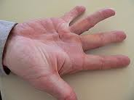
1 month later
84y female for correction of duputytren contracture under brachial plexus block
Medication error: 40ml of 1% ropivacaine instead of 0.5% ropivacaine
15 min pt lost consciousness/seizures. Intubated.
100mg thiopental
Few minutes later bradycardia then asystole
CPR (including 3mg of epi in divided doses)
10 minutes (all ACLS failed)
100ml of 20% lipid emulsion → continuous infusion 10ml/min
chest compression continued
After 200ml of lipids, wide complex tachyarrhythmias to NSR
Litz et al., Anaesthesia, 2006

Slide 36
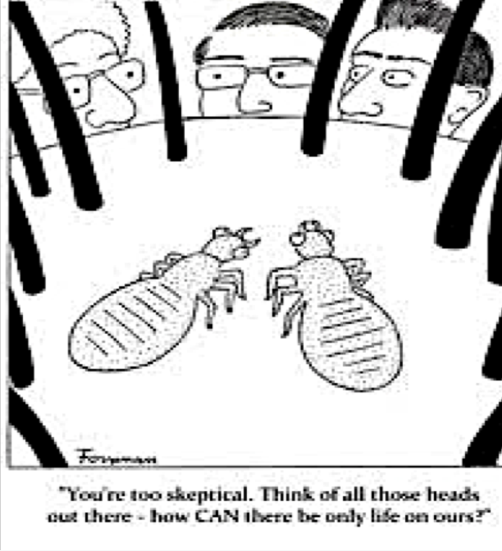
Not so fast
In 2006 a nineteen question survey was sent to 135 Academic Anesthesia departments in the US regarding use of Lipid Emulsion
74% of the respondents said their institutions would not consider using lipid emulsions
Corcoran et al., Anesth Analg, 2006

Slide 37
Lipid Mania
4 case reports in May 2008 issue in Anesthesia & Analgesia
1. Thirteen year old girl for meniscectomy L knee
Received lumbar plexus block (11ml of 1% lidocaine and 11ml of 0.75% ropivacaine)
V-tach and widening QRS patterns. Altered BP, pulse ox to 92%.
Local toxicity suspected 150ml of 20% lipid emulsion. 2 minutes later NSR, pulse ox to 99%, BP stable.
Surgery completed with no further complications

Slide 38
2. Ninety-one year old man for olcranon bursitis surgery
Infraclavicular brachial plexus block (30ml of 1% mepivacaine).
Incomplete ulnar nerve block.
Additional 10ml of prilocaine
Dizziness, nausea, agitation, unresponsive to verbal stim
LA toxicity suspected → 50ml of 20% fat emulsion, repeat dose of 50ml 3 minutes later.
Continuous fat emulsion drip at 0.25ml/kg/min
Regained consciousness after 5 minutes of drip and after total dose of 200ml→ arrhythmias disappeared.

Slide 39
83yr old woman for total knee arthroplasty
healthy, lived independently
Anesthesia Management
Femoral and sciatic block for post-op pain. Spinal for intra-op anesthesia management
Fem block – (15ml of 0.5% bupivacaine w/ epi, 15ml of 1% ropivacaine)
Sciatic block consisted of the exact same local anesthetic
10 minutes after sciatic. VS deteriorated.
Bradycardia (30-40bpm) to wide complex v-tach, BP (60-70mmHg systolic)
5 minutes of ACLS
250ml of 20% lipid emulsion over 30 minutes, followed by another 250ml
4-5 minutes patient converted to NSR
Varela at el., AANA Journal 2010

Slide 40
69yr woman presented to ER w/ femoral neck fracture
Received bupivacaine femoral nerve block for pre-op analgesia
Seizure and cardiovascular collapse developed immediately after LA
20% lipid emulsion was successful in normalization in hemodynamic parameters
Harvey et al., Emerg Med Australas 2011

Slide 41
24 yr old surgery for fx L clavicle
Interscalene Brachial Plexus Block
Received 40ml of 0.5% ropivacaine
General anesthesia was induced
Operation completed uneventful**
Pt restless and twitching upon emergence
Toxicity was suspected
100ml of 20% LE
S/S disappeared
Full recovery of consciousness in 5 Minutes (like my case)*
Mizutani et al., J Anesth 2011
Notes:
This was very similar to the case I indicated in the beginning **

Slide 42
System Review & Meta-Analysis
Confirms efficacy of LE
According to study, no clear cut better commercial LE ( Intralipid, Medialipid, etc)
No benefit when epi or vasopressin administered
In rat studies, large epi dose actually prolongs ROSC
1.5ml/kg bolus dose; infusion of up to 0.5ml/kg/min
Seong-Ho Ok et al., Int J Med Sci 2018
Notes:
Antidipresent

Slide 43
Other implications
36 yr old ingested 5.25g of dosulepin
Widening QRS, HR 113, BP⬇
LOC deteriorated and seizures
Bicarb administered
Cardiac instability continued
LE therapy
BP stabilized, seizures and CNS symptoms subsided
Boegevig et al., Clinical Toxicology 2011
Notes:
Antidipresent

Slide 44
4yr old presents to ER w/ tachycardia & agitation
Followed by somnolence after presumed accidental olanzapine ingestion (1-3 hrs before)
Lipid emulsion ameliorated symptoms
When LE stopped –reoccurrence of symptoms
Discontinued when LE started again
S/S dissipated. No adverse effects
McAllister et al., Am J of Emerg Med
Notes:
Antiphysicotic

Slide 45
32-year-old male with depression and chronic neuropathic pain presents to ED after an intentional overdose of 50 tablets of 75 mg amitriptyline
Successful conversion of lethal arrhythmia after lipid emulsion therapy
Medical Concepts Canadian Journal , Baylis, 2017

Slide 46
Study – classification of detoxification of acute pharmacotoxicity by a triglyceride micro emulsion
Goal: Create a method to predict which drug toxicities are most amendable to lipid emulsion treatment to help treat drug overdose
Fettiplace et al., Journal of Controlled Release Vol 198, (62-70)

Slide 47
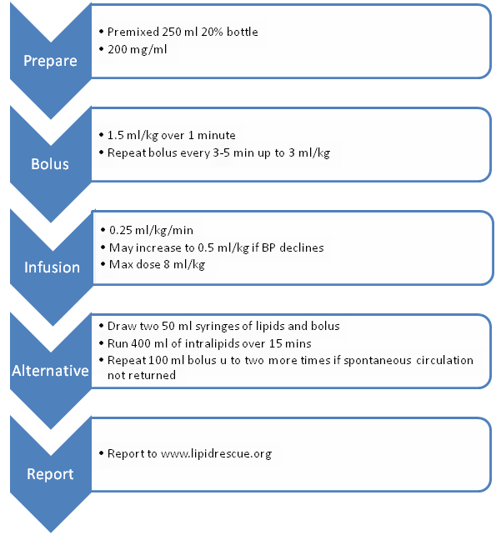

Slide 48
Conclusions
Lipid Emulsion should be considered as first line treatment for local anesthesia toxicity and seriously considered for lipid soluble drug overdose
Anesthesia providers should be trained in LE rescue therapy
LE rescue kit should be available where LA are regularly administered

Slide 49
“the point is to spread the word – by then we can save lives.”
Guy Weinberg

