Slide 1
Surgical Pain Management for Hot patients
Thomas Baribeault DNP CRNA
@BaribeaultOFA

Slide 2
1.
Introduction

Slide 3
Pain
Fentanyl became an integral part of anesthesia in the 1960’s as balanced anesthesia was more hemodynamically stable.
The opioid epidemic and chronic pain epidemic have dramatically reduced the effectiveness of opioids in anesthesia and made it necessary to find other methods of treating surgical pain.
The obesity epidemic as well as increased knowledge of opioid-related adverse drug events (ORADES), have increased the risk profile of opioids during anesthesia.

Slide 4
2.
Neurotransmitters & Receptors

Slide 5
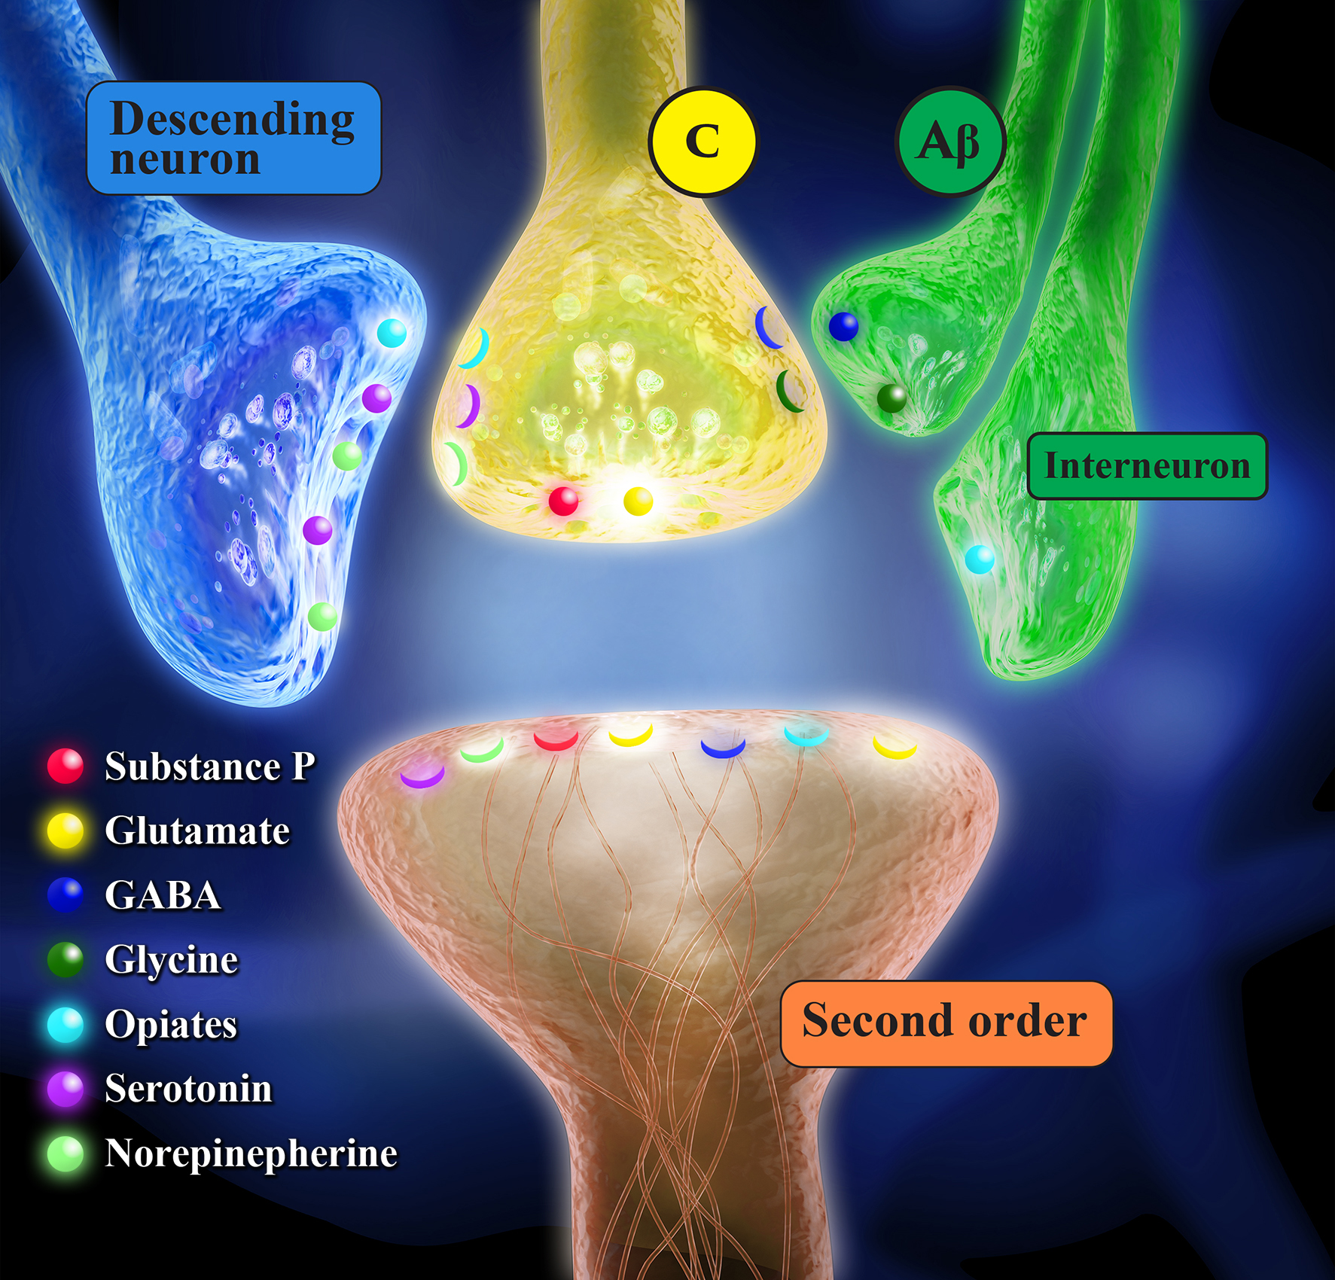
Excitatory Neurotransmitters
Glutamate
Primary neurotransmitter
AMPA/Na, NMDA/Ca, Kainate/Na & Ca, 8 mGluR
Substance P
NK1
Microglial Cells
Peripheral nerve injury causes release inflammatory mediators

Slide 6
Inhibitory Neurotransmitters
GABA
GABA A & B receptor
Pre & Post synaptic
Glycine
Strych receptors
Pre & Post Synaptic

Slide 7
Inhibitory Neurotransmitters
Norepinephrine
Alpha 2 receptor
Pre & Post Synaptic
Serotonin
5HT2 receptor
Post-synaptic

Slide 8
Inhibitory Neurotransmitters
Endorphin, dynorphin, enkephalin
Mu, Kappa, Delta
Pre & Post Synaptic
Inhibit Ca & K ion channels

Slide 9
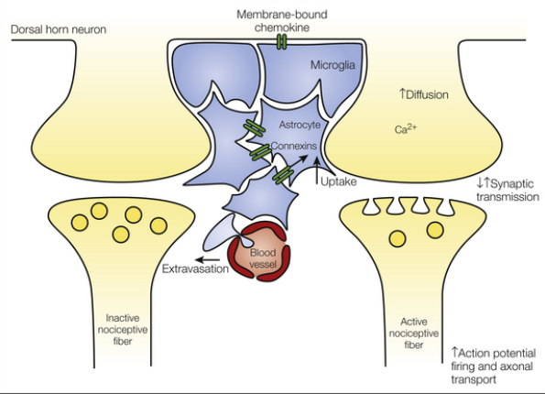
Inhibitory Neurotransmitters
Endocannbinoids
Anandamide & 2AG
CB1 & CB2 receptors
Inhibit microglia release of inflammatory mediators

Slide 10
3.
HOT Pathophysiology

Slide 11
HOT
Long term opioid therapy
Illicit opioid use
Medication assisted therapy
Methadone
Buprenorphine
Suboxone
Subutex
Naltrexone (Vivitrol)

Slide 12
HOT
Methadone
Broad spectrum opioid
Mu, Delta, Kappa, and NMDA receptor
Blocks opioid tolerance and hyperalgesia
6-8 hour alpha phase elimination
400% inter-patient variability
Respiratory depression can outlast analgesia
Prolongs QT interval

Slide 13
HOT
Buprenorphine
Partial agonist Mu receptor
Less sedation, nausea, pruritis, respiratory depression, urinary retention
Higher affinity/slower disassociation than full Mu agonist
Subutex
Buprenorphine
Higher abuse risk
Suboxone
Buprenorphine + Naloxone

Slide 14
HOT
Naltrexone (Vivitrol)
Antagonist Mu receptor
Can’t start until withdrawal
Monthly injection
Least potential for abuse

Slide 15
Day of surgery Recommendations
Opioids
Continue
Methadone
Continue
Buprenorphine or Naltrexone
Minor surgery continue
Major surgery wean vs continue
Can we control pain?
Is there a plan?
Wean
3 day Buprenorphine
28 days Naltrexone

Slide 16
Fibromyalgia
Multiple conditions
Similar pathophysiology
Diagnosis
Widespread pain index >7
Symptom severity score >5
>3 months
Not explained by any other condition
Fibromyalgia-ness score
Predictive of post-operative pain and opioids requirements

Slide 17
Fibromyalgia
Symptoms
Magnified sensory transmission
“volume knob concept”
Pain, allodynia (tender points), heat & cold, auditory, and visual stimuli
+/- inflammation
Sleep disruption
Memory problems
Poor exercise tolerance
Depression

Slide 18
Fibromyalgia
Treatment
Aerobic exercise
Cognitive behavioral therapy
Medical
Anti-depressants
TCA Amitriptyline
SSRI/SSNI Duloxetine
Gabapentinoid
Gabapentin/Pregabalin

Slide 19
Fibromyalgia
Treatment
Tizandine
Muscle relaxant with A2 agonist activity
Tramadol/Tapentadol
Opioid with SSRI activity
Unsuccessful
Opioids
Overproduction of endogenous opioids
Acetaminophen/Nsaids

Slide 20
4.
Pharmacology

Slide 21
Options organized by pathway
Ca & K channels
Opioids
Na channels
Local anesthetics
Glutamate
Gabapentin/Pregabalin
NMDA Receptor
Ketamine, N2O, Magnesium
Substance P
Dexmedetomidine, Clonidine

Slide 22
Options organized by pathway
Serotonin/Norepinephrine
Duloxetine, Tramadol, Tapentadol
Inflammation
Dexamethasone
NSAIDS
Acetaminophen

Slide 23
Pharmacology
Opioids
Benefit
No ceiling effect, limited by side effects
Reversible
Disadvantage
Respiratory depression
Sedation
PONV
Hallucinations
Long term/high dose/high potency
Sisyphus effect = hyperalgesia + tolerance
Dependence

Slide 24
NA channel Block (Regional Anesthesia/Lidocaine Infusion)
Dose
1-2 mg/kg
2-3 mg/kg/hr
Mechanism
Systemic analgesia 2, 8, 48 hours
Blocks prostaglandin release
Considerations
Safety
2-3 mcg/ml plasma concentration

Slide 25
Gabapentin/Pregabalin
Dose
Gabapentin 300-600 mg
Pregabalin 75-150 mg
Mechanism
Blocks release of glutamate
Benefits
Reduction in chronic post-surgical pain
Better reduction of neuropathic pain

Slide 26
Gabapentin/Pregabalin
Considerations
Increases respiratory depression when used with opioids
Post-operative sedation/dizziness
Pregabalin fast absorption, more consistent plasma levels
Pregabalin rare side effects
Angioedema, thrombocytopenia, rhabdomyolysis, increased pr interval

Slide 27
Ketamine
Dose
0.1-0.3 mg/kg
0.3-0.5 mg/kg
0.1-0.5 mg/kg/hr = 2-10 mcg/kg/min
1:1 morphine PCA
Mechanism
Blocks NMDA receptor

Slide 28
Ketamine
Benefits
Bronchodilator
Treatment for depression, suicidal ideation, and PTSD
Considerations
Caution cardiovascular disease, increased ICP, and catecholamine depression
Hallucinations/disassociation
Reverse and prevent OIH/OT

Slide 29
N2O
Dose
50% ET = 15 mg morphine
Mechanism
Blocks NMDA receptor
Benefits
Can reverse hyperalgesia
Considerations
PONV
Caution in pulmonary hypertension, B12 anemia, and respiratory disease

Slide 30
Magnesium
Dose
30-50 mg/kg
10 mg/kg/hr infusion
Mechanism
Prevents loss of Mg plug from NMDA receptor
Benefits
Prevent post-operative shivering
Reduces burn from Propofol
Considerations
Caution in renal failure
Prolongs NMB

Slide 31
Dexmedetomidine
Dose
0.1-0.5 mcg/kg over 10 minutes
0.2-1 mcg/kg/hr
Mechanism
Sedation
Blocks norepinephrine in the locus coeruleus
Pain
Blocks substance P from binding to the NK1 receptor

Slide 32
Dexmedetomidine
Benefits
Reduced emergence delirium
Anxiolysis
Prevents post-operative shivering
Considerations
Caution tachy/bradycardia, hyper/hypotension
Post-operative sedation

Slide 33
Clonidine
Dose
2-3 mcg/kg IV
3-5 mcg/kg PO
Mechanism
Same as dexmedetomidine
Considerations
12 hour half life
Less specific for pain/sedation receptors than dexmedetomidine

Slide 34
Serotonin/Norepinephrine
Tramadol/Tapentadol
50-100 mg
Opioid + SSRI
Duloxetine
20-30 mg
SSRI/SSNI

Slide 35
Dexamethasone
Dose
0.1-0.2 mg/kg
Mechanism
Inhibits prostaglandins, leukotrienes, and histamine
Considerations
Does not inhibit healing
Raise blood sugar?

Slide 36
NSAID/Coxib
Cox 1 vs Cox 2 inhibition
Cox 1
Gastric ulcer
Platelet dysfunction
Renal dysfunction
Cox 2
Renal dysfunction
Reduces pain, fever, and inflammation
Contraindications
renal failure, gi bleed, thrombotic event, CABG, age >60, thrombocytopenia

Slide 37
NSAID/Coxib
Non-selective cox inhibitors
Ketorolac PO, IV
Meloxicam PO, IV
Ibuprofen PO, IV, TD
Diclofenac PO, IV, TD
Naproxen PO
Cox 2 inhibitor
Celecoxib PO
Parecoxib IV (Non-US)

Slide 38
Acetaminophen
Dose
1G
Mechanism
Unknown
Considerations
Liver dysfunction
IV vs PO
Endocannbinoid reuptake inhibitor

Slide 39
Questions?

